Slide 1
Improving Child Fatality Review Capacity to Review Infant Deaths North Carolina Child Fatality Prevention System
Susanna Joy

Slide 2
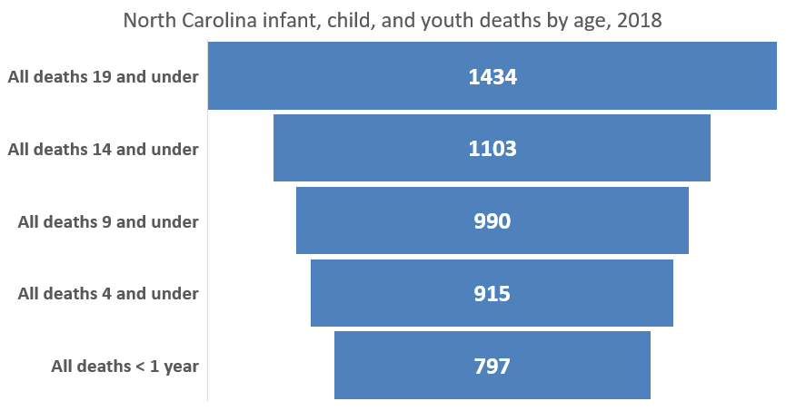
Infant deaths accounted for 56% of North Carolina deaths age 19 and under in 2018.
Centers for Disease Control and Prevention, National Center for Health Statistics. Underlying Cause of Death 1999-2018 on CDC WONDER Online Database, released in 2020. Data are from the Multiple Cause of Death Files, 1999-2018, as compiled from data provided by the 57 vital statistics jurisdictions through the Vital Statistics Cooperative Program. Accessed at http://wonder.cdc.gov/ucd-icd10.html on Feb 17, 2020 11:21:18 AM
Notes:
This slide has data from CDC Wonder. The following slide has a final 2018 infant death count of 806 as opposed to the 797 mentioned here; those data came from the state health department, and may have been more recent, or simply looking at “NC residents” as opposed to deaths that happened in NC. I will address this discrepancy in my presentation.

Slide 3
Of those, the vast majority were due to natural causes.
Natural infant deaths = 601/806, or 75%

Slide 4
Approaches to case selection
Local or state priorities
Issues with which team is already familiar
Special populations or noted disparities
Immigrant communities
Partner’s priorities
Medicaid/WIC eligibility
Healthy Start CAN initiatives
Domestic violence or CPS involvement in home
Title V priorities for infant mortality reduction
Family First Prevention Services Act
Leading causes of death

Slide 5
Approaches to case selection
Infant age
Infant Mortality In North Carolina, Kathleen Jones-Vessey, Feb, 10, 2020
https://www.ncleg.gov/DocumentSites/Committees/NCCFTF/Perinatal%20Health/2019-2020/presentations%20and%20handouts/IMR%20Data%20Update%2010FEB2020.pdf

Slide 6
Approaches to case selection
Shared risk factors approach
SUID
Prematurity-related fatality
MATERNAL SMOKING

Slide 7
Considerations for case selection
Reflect community priorities
Case selection criteria can change periodically
Prioritize records access and team participation
Make participation/input as easy as possible

Slide 8
Considerations for case review
Different records
More clinical records (mom & baby)
Home visiting records
Maternal CPS records as victim

Slide 9
More considerations for review
Different expertise
Clinical experts
Maternal child health experts
Maternal/family perspective

Slide 10
Considerations for prevention
Direct links can be more challenging to identify than in injury prevention
Overall maternal AND infant health impacts outcomes
Deeply rooted in the social determinants of health (SDOH)
https://hitconsultant.net/2019/03/18/social-determinants-of-health-sdoh-collection/#.Xkqmgr1Kg2w

Slide 11
Considerations for prevention
Improved service delivery, referral processes, and MCH programs are common recommendations
Addressing root cause SDOH addresses risk for other causes of death
Notes:
Will share a worksheet in the longer workgroup with PPOR prevention strategies and our NCFRP document on reviewing natural infant deaths to highlight specific possible strategies

Slide 12
Thanks and Questions
Gratefully acknowledge the data support from Kathleen Jones-Vessey, epidemiologist with the Women and Children’s Health Section of the North Carolina Division of Public Health

