Slide 1
the NC Child fatality prevention system: Overview & child fatality task force recommendations to strengthen the system
Kella Hatcher, JD
Executive Director
NC Child Fatality Task Force

Slide 2
Public Policy that Anchors CFP System
“The General Assembly finds that it is the public policy of this State to prevent the abuse, neglect, and death of juveniles. The General Assembly further finds that the prevention of the abuse, neglect, and death of juveniles is a community responsibility; that professionals from disparate disciplines have responsibilities for children or juveniles and have expertise that can promote their safety and well-being; and that multidisciplinary reviews of the abuse, neglect, and death of juveniles can lead to a greater understanding of the causes and methods of preventing these deaths.”
N.C.G.S. §7B-1400
Notes:
Slide. . .

Slide 3
Charge of State Child Fatality Prevention System [via Article 14 of NC Juvenile Code]
Develop a communitywide approach to child abuse and neglect;
Study and understand causes of childhood death;
Identify gaps in service delivery in systems designed to prevent abuse, neglect, and death; and
Make and implement recommendations for laws, rules, and policies that will support the safe and healthy development of our children and prevent future child abuse, neglect, and death.

Slide 4
Three main components to NC cfp systeM
Local Teams
State Team
Task Force

Slide 5
Local Teams: CCPTs & CFPTs
CCPT
Must review deaths involving suspected abuse or neglect where there was CPS involvement/report within previous 12 mos., as well as selected active CPS cases
May review “additional” types of deaths
CFPT
Reviews “additional” types of deaths when CCPT determines it will not review additional cases
Most teams
are blended
See N.C.G.S §7B-1406

Slide 6
Support for Local Teams
CCPTs
NC Division of Social Services has ongoing responsibility for training materials for local CCPTs (a CCPT Consultant in NC DSS supports this training)
CFPTs
Local Health Department Directors distribute procedures, maintain records, provide staff support, facilitate reports, etc.
A Team Coordinator at NC DPH:
County DSS Directors provide general support, procedures, training, reporting, etc.
A CCPT State Advisory Board was formed by NC DSS and it facilitates CCPT reporting
provides general support, procedures, training, reporting;
provides statistical information on child deaths to CFPTs;
receives and sends reports from CFPTs;
evaluates impact of local efforts.

Slide 7
Membership of local teams [See N.C.G.S. §7B-1407]
DSS Director
Member of DSS staff
Local law enforcement
Atty from D.A.’s office
ED of local community action agency
School Superintendent
Member of SS Board
Local mental health professional
Local GAL coordinator
Local Public Health Director
Local health care provider
BCC may appoint 5 additional

Slide 8
Additional Members of local cfpt (teams reviewing “additional” deaths)
EMS provider or firefighter
District court judge
County medical examiner
Representative of local child care facility or Head Start
Parent of a child who died before reaching the child’s 18th BD

Slide 9
Local teams. . .
Meet at least once per quarter
Report annually any recommendations to Boards of County Commissioners
Aggregate reports from CFPTs go to State Team & other Local Teams via Team Coordinator; reports on activities go to local board of health via health director
Reports on activities of CCPTs go to local DSS boards via DSS director (and per DSS policy, CCPTs submit copy of BCC report to NC DSS along with CCPT End of Year Report)
Advocate for system improvements and needed resources where gaps and deficiencies exist
See G.S. §7B-1406

Slide 10
State Child Fatality Prevention Team (State Team)
State Team, chaired by Chief ME, is required to review deaths of children attributed to child abuse or neglect or when decedent reported as abused or neglected
In practice, State Team also reviews other types of child fatalities in NC that are investigated by the statewide Medical Examiner System
OCME Child Fatality staff review all child deaths investigated by the statewide medical examiner system
State Team also provides technical assistance to local teams, receives local team information, and makes reports and recommendations to Task Force.
See G.S. §7B-1404, -05; State Team website:
http://www.ocme.dhhs.nc.gov/nccfpp/index.shtml
Notes:
Deaths investigated by medical examiners include apparent accidents, homicides, suicides, violent deaths, deaths occurring under suspicious circumstances, and sudden and unexpected deaths of children in apparent good health.

Slide 11
State Team Members and Leadership
Chief Medical Examiner is a member and also chair of the State Team
State DSS Director or designee
Director of the State Bureau of Investigation or designee
Director of Maternal & Child Health for DPH or designee
Director of the Division of Mental Health, Developmental Disabilities and Substance Abuse Services or designee
Director of the Administrative Office of the Court or designee
Pediatrician appointed to serve on the Child Fatality Task Force
Appointed public member
Team Coordinator (for CFPTs statewide)

Slide 12
NC Child Fatality Task Force: Legislative study commission created via statute in 1991
The “policy arm” of the State’s Child Fatality Prevention System
Does NOT review individual cases
35 Members:
20 Appointed;
11 Ex Officio
(State agency & community leaders, experts in child health & safety, 10 legislators)

Slide 13
Task Force Responsibilities
Study, analyze, and report on incidences and causes of child death
Develop a system for multidisciplinary review of child deaths
Receive and consider reports from State Team
Perform other studies and evaluations as needed in order to carry out its mandate
Submit annual report to the Governor and General Assembly with recommendations for changes to any law, rule, or policy that it has determined will promote the safety and well-being of children
See G.S. §7B-1403, -1412

Slide 14
Child Death Data
Released by the Task Force
Examined by the Task Force
Used to inform Task Force recommendations
Good Data
Informed Policy-makers
Good
Policy

Slide 15
Three Task Force Committees work to create a yearly “Action agenda”
Full CFTF
Intentional Death Prevention
Perinatal Health
Unintentional Death Prevention
Committees rely on CFTF members AND community volunteers.

Slide 16
Task Force Process Components
Public meetings between legislative sessions (10-12 meetings with 45-50 presentations per study cycle)
Stakeholder or work groups may be formed to address or examine in-depth a particular issue to bring more information back to the CFTF
Ongoing information sharing and collaboration among experts and community partners
Committees propose recommendations to full Task Force

Slide 17
BUT WAIT! THERE’S MORE. . .
Three organizations that are not part of the Article 14 statutes addressing the Child Fatality Prevention System have a connection to the system:
NC Child Fatality Review Team (DSS Intensive Reviews)
CCPT State Advisory Board
Federally required Citizen Review Panels
Notes:
That’s it for the Child Fatality Prevention System encompassed in Article 14 of the Juvenile Code.
HOWEVER, statutes and policy have created other groups that deal with fatality reviews.
Intensive reviews, G.S. §143B-150.20:
State DSS child fatality reviewers convene special local teams that utilize some local team members.
Conduct longer, more in-depth (as compared to CCPT) fatality reviews of children involved with DSS in 12 months preceding fatality where factors related to abuse or neglect may have contributed to conditions leading to the child’s death.
Findings and recommendations related to improving coordination between local and state entities are made public after consultation with D.A. [Per DSS policy, reports are sent to CCPT & CFPT chairs, State Team, director of local DSS, state DSS, and others.]
CCPT Advisory Board:
Not statutorily required
Diverse membership from local and state agencies & organizations
Works with multidisciplinary team at N.C.S.U. to survey CCPTs and based on survey results, prepares annual report with recommendations to state DSS
State responds in writing to recommendations
Annual report and state’s response go into annual report to the US DHHS
Citizen Review Panels:
Required by federal law CAPTA
Minimum of 3 per state; NC has designated CCPTs as CRPs, so there are technically 100 in NC
General purpose: examine policies, procedures, practices of state and local child protection agencies and, where appropriate, specific cases (including fatalities) to evaluate effectiveness and adherence to law and policies in order to ensure protection of children
BUT . . .
There are differences with activities and responsibilities, types of required members, required reports, and state response for CCPTs compared to CRPs

Slide 18
DSS Intensive Reviews
Outside of the CFP System in Article 14 of Juvenile Code is the “State Child Fatality Review Team,” who conducts what are known as “DSS Intensive Reviews,” required by G.S. §143B-150.20.
State DSS child fatality reviewers convene special local teams that utilize some local team members.
Conduct longer, more in-depth (as compared to CCPT) fatality reviews of children involved with DSS in 12 months preceding fatality where factors related to abuse or neglect may have contributed to conditions leading to the child’s death.
Findings and recommendations related to improving coordination between local and state entities are made public after consultation with D.A. [Per DSS policy, reports are sent to CCPT & CFPT chairs, State Team, director of local DSS, state DSS, and others.]
See also DSS Family Services Manual, Volume I, Chapter VIII, Section 1432
Notes:
[DSS directors must report to state DSS child fatalities that are a result of maltreatment. State DSS then uses these reports to determine whether to conduct an intensive review.]

Slide 19
CCPT State Advisory Board
Not statutorily required
Diverse membership from local and state agencies & organizations
Works with multidisciplinary team at N.C.S.U. to survey CCPTs and based on survey results, prepares annual report with recommendations to state DSS (related to federal Citizen Review Panel requirements)
State responds in writing to recommendations
Annual report and state’s response go into annual report to the US DHHS
Currently working on new efforts related to Citizen Review Panels

Slide 20
Citizen Review Panels (CRPs)
Required by federal law CAPTA
Minimum of 3 per state; NC has designated CCPTs as CRPs, so there are technically 100 in NC
General purpose: examine policies, procedures, practices of state and local child protection agencies and, where appropriate, specific cases (including fatalities) to evaluate effectiveness and adherence to law and policies in order to ensure protection of children
BUT . . .
There are differences with activities and responsibilities, types of required members, required reports, and state response for CCPTs compared to CRPs
Notes:
[DSS Family Services Manual Volume I, Chapter VIII, Section 1434]

Slide 21
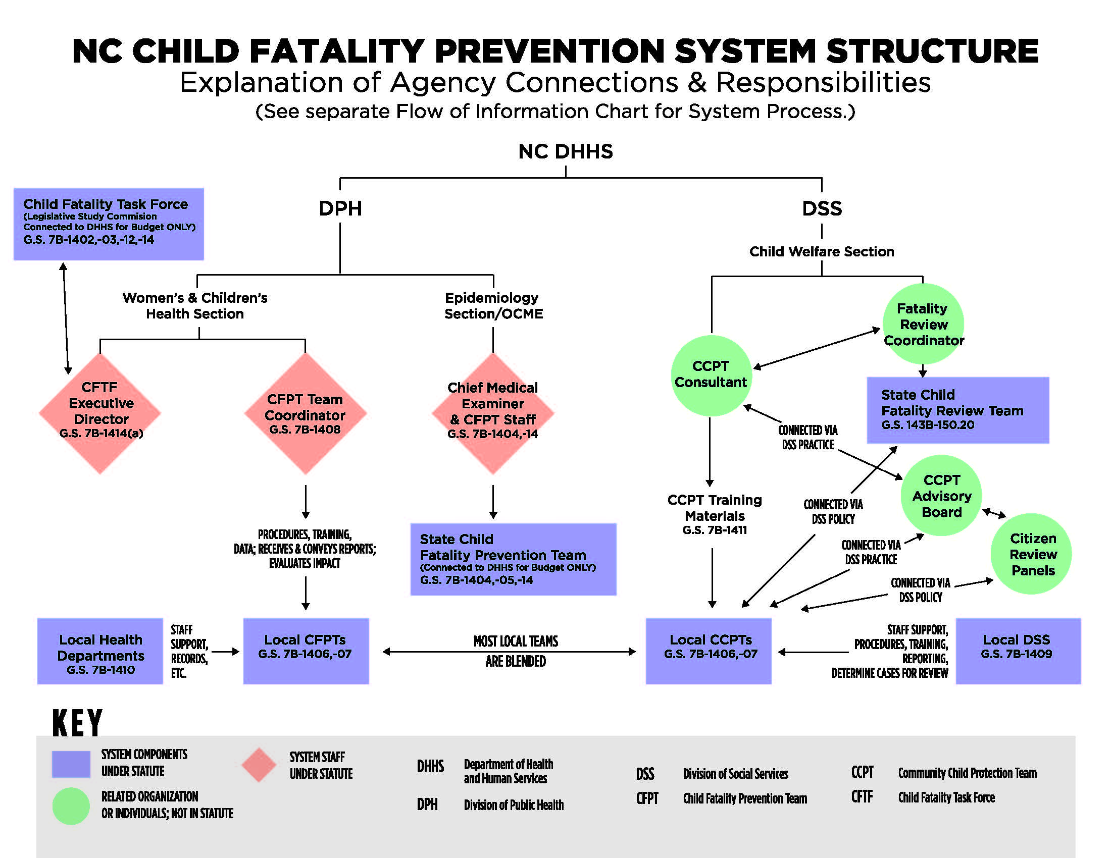

Slide 22
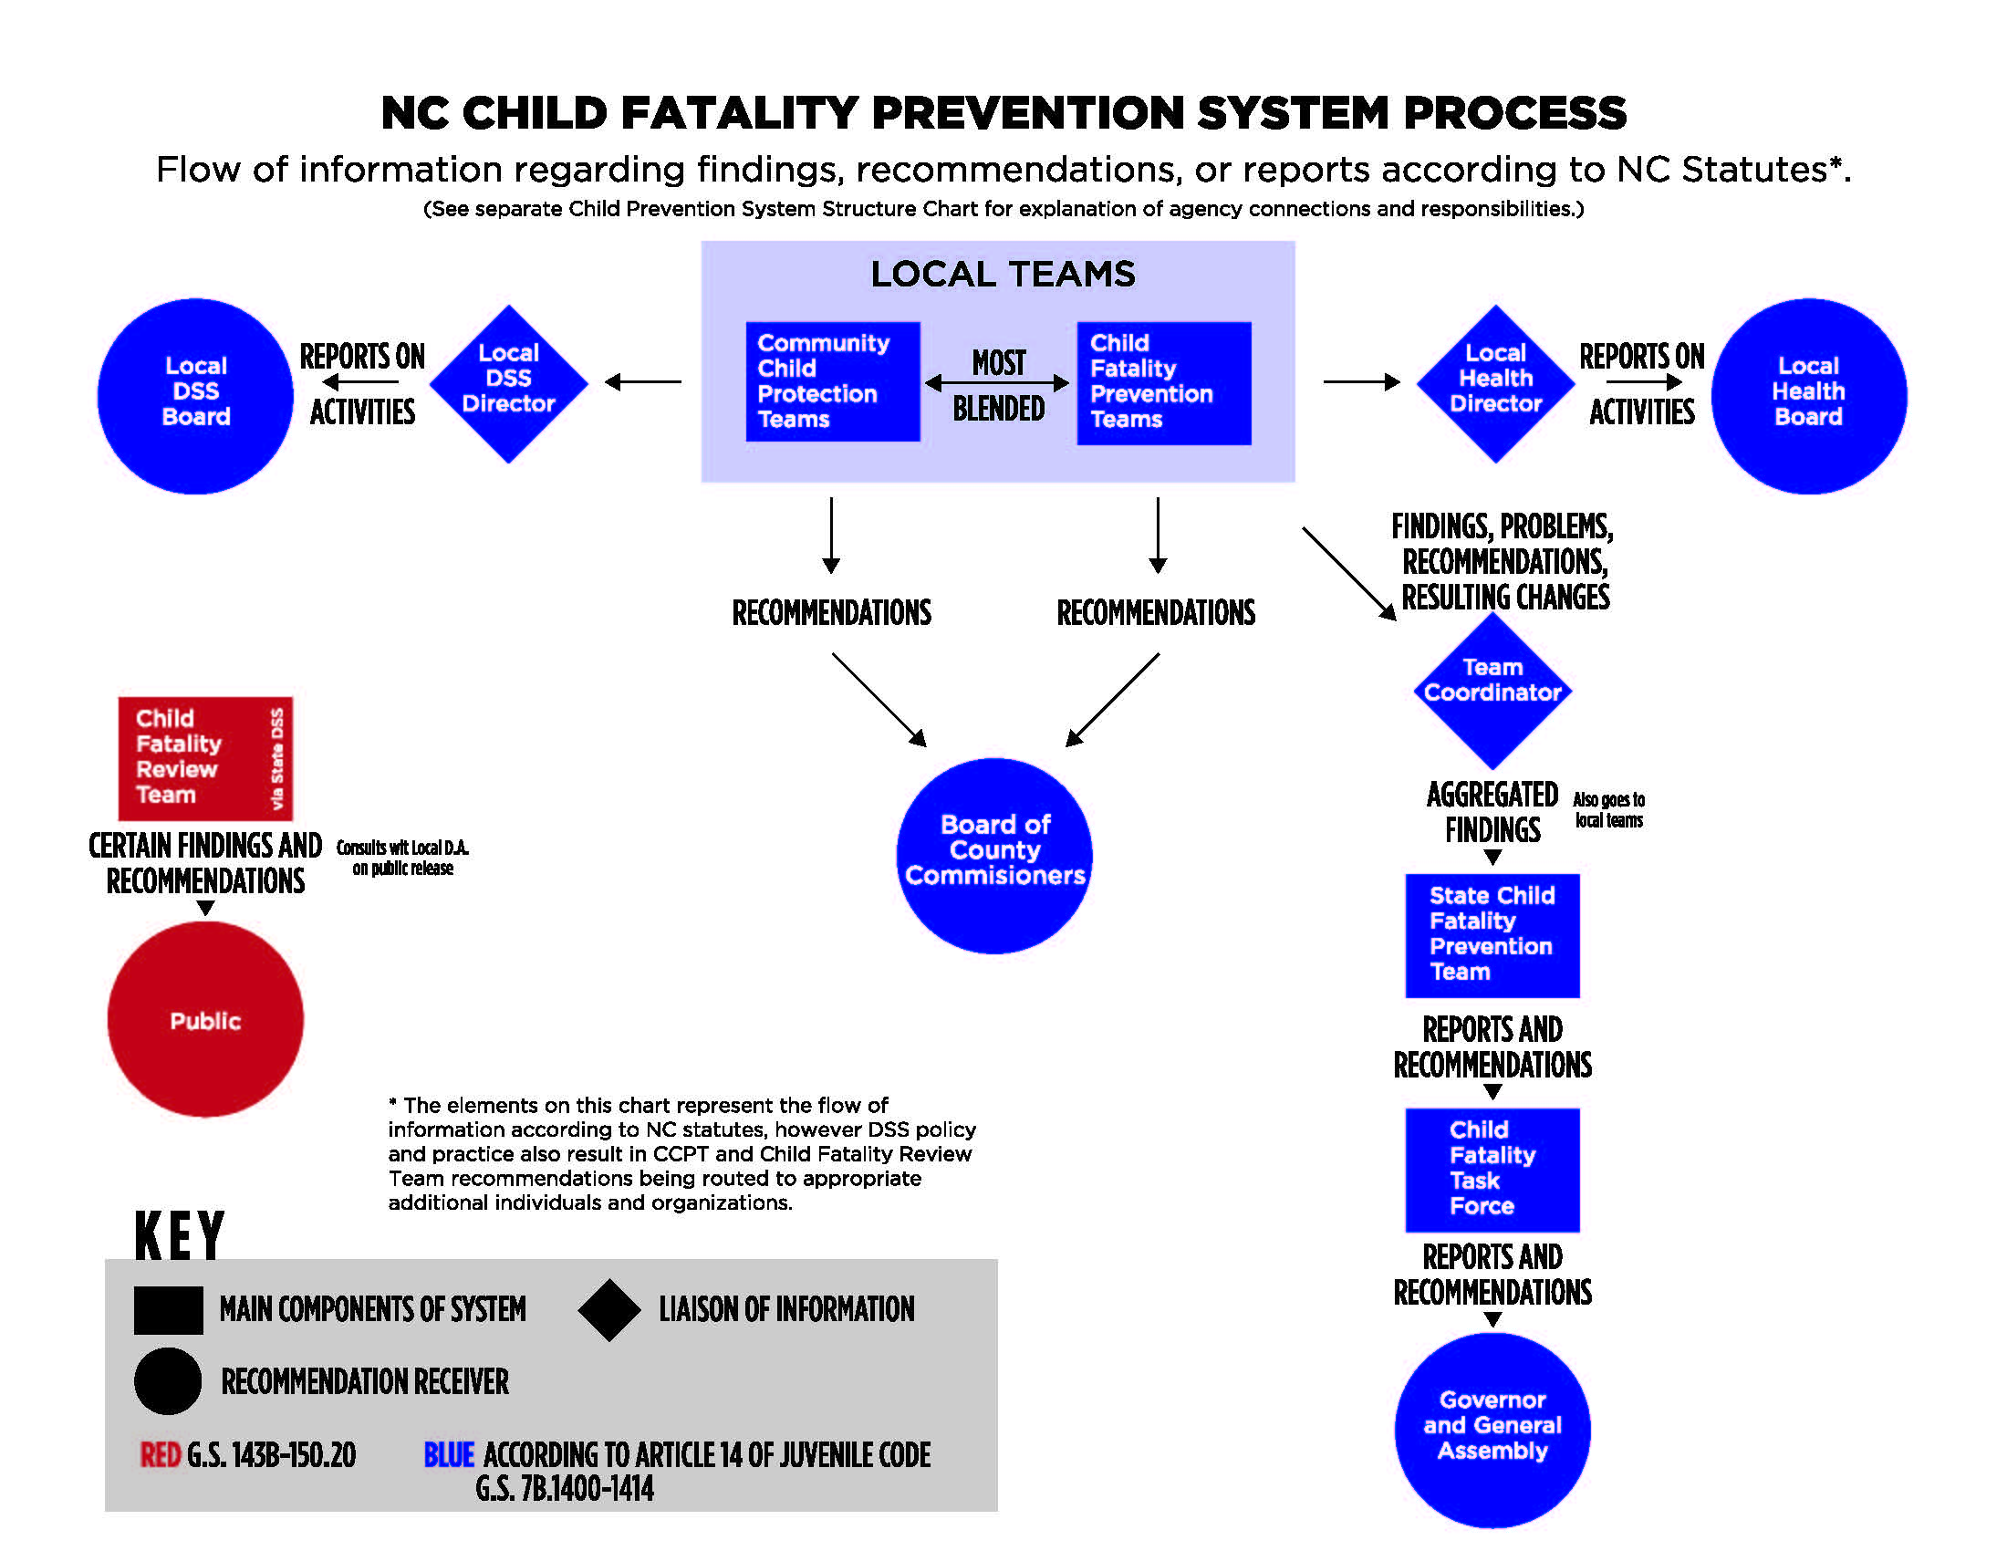

Slide 23
Child Fatality Task force 2019 Recommendations to strengthen the Child fatality prevention system

Slide 24
Events & sources that led to recommendations:
Administrative item on 2018 Child Fatality Task Force (CFTF) Action Agenda to support Child Fatality Prevention (CFP) System Summit and for CFTF to hear reports on summit work.
Two-day Child Fatality Prevention System Summit April 2018: gathering of over 200 people
Post-Summit meetings among summit group facilitators identified three areas in need of focus: 1) system structure, 2) data, and 3) support and collaboration for child death review teams.
National experts facilitated post-Summit stakeholder discussion about CFP system strengths and challenges; other discussions among stakeholders about data and ideas for structural changes.
Recommendations and findings in the Preliminary Reform Plan from the Center for the Support of Families which have overlap/alignment with CFTF recommendations. [Note: their Final Plan of May 6, 2019 adopts all CFTF recommendations: https://files.nc.gov/ncosbm/documents/files/ChildWelfareReform_FinalPlan.pdf.]
Consultation with national child fatality prevention experts and research on other states’ child fatality prevention systems.
Discussion, alteration, and approval of draft proposed changes by CFTF Perinatal Health Committee (CFP stakeholders invited to participate), then discussion and approval by full CFTF.

Slide 25
CFP System recommendations from CFTF
I. Implement centralized state-level staff with whole-system oversight in one location; OCME child fatality staff remains in OCME; form new Fatality Review and Data Group to be information liaison.
II. Implement a centralized electronic data and information system that includes North Carolina participating in the National Child Death Review Case Reporting System.
III. Reduce the volume of team reviews by changing the types of deaths required to be reviewed by fatality review teams to be according to certain categories most likely to yield prevention opportunities.
IV. Reduce the number and types of teams performing fatality reviews by combining the functions of the four current types of teams into one with different procedures and required participants for different types of reviews and giving teams the option to choose whether to be single or multi-county teams. DHHS should study and determine an effective framework for meeting federal requirements for Citizen Review Panels and for reviewing active DSS cases.
V. Formalize the 3 CFTF Committees with certain required members; expand CFTF reports to address whole CFP System and to be distributed to additional state leaders.
Recommendations were also made to maintain current CFP funding and appropriate additional funds to support restructuring and to strengthen the system.
More detailed recommendations can be found on the CFTF website here: https://www.ncleg.net/DocumentSites/Committees/NCCFTF/in%20the%20spotlight/CFTF%20Child%20Fatality%20Prevention%20System%20Recommendations%20for%202019.pdf

Slide 26
What will a central office in one location accomplish?
Connects system components
New FRD group ensures connection of information among local teams, OCME, and CFTF
Centralizes leadership; streamlines state-level support functions
Team approach increases efficiency, capacity, standardizes tools and resources for all teams

Slide 27
What will a centralized Information system and joining the national DATA system accomplish?
Maximizes usefulness of data & information learned from reviews
Ensures entry of data and submission of reports by all teams
Ensures expert data analysis and production of meaningful data reports
Standardization and management of data protocols to support appropriate data protection and sharing
Expands, modernizes, and standardizes data capture, analysis, and reporting

Slide 28
What will be accomplished by focusing team reviews on 9 or more categories of death most likely to yield prevention opportunities?
Undetermined causes
Unintentional injury
Violence
Motor vehicle incidents
Child abuse or neglect/CPS involvement
Sudden unexpected infant death
Suicide
Deaths not expected in the next 6 months
[Potential for additional special criteria for infant deaths; other deaths; FIMR]
Optimization of efforts & resources toward those reviews most likely to yield identification of prevention opportunities
Increased capacity for strengthened reviews of infant deaths which make up 2/3 of all child deaths
More prevention opportunities identified = more motivated and engaged team members
Notes:
All of these causes are currently the types of deaths reviewed in the ME system and the OCME has said there are roughly 500 such child deaths per year. However, there is the potential here for additional infant deaths to be reviewed

Slide 29
What will be accomplished by Consolidating review teams?
Eliminates duplication of team reviews to optimize overall efforts & resources
Allows for streamlining, standardizing, and improving processes and procedures for all team reviews
Preserves critical functions & diverse contributions of expertise by multidisciplinary teams and state-level staff.
Recognizes strength of local team information and input.
Recognizes that in some areas, counties’ ability to combine teams may optimize efforts.
There is a more effective way to have Citizen Review Panels and to review active DSS cases than using all CCPTs for this purpose.
Notes:
Single review team at local level; no separate local CCPT & CFPT, DSS Intensive, or State CFPT reviews.
BUT -- different procedures and required participants for different reviews. For example:
Abuse/neglect/CPS related cases still get intensive-type reviews with technical onsite assistance from state-level staff
Reviews of certain infants deaths or other types of deaths may be different (as determined by DHHS)
Teams can choose to be single or multi-county.
Separate state-level team review would not be routine but could be only in certain circumstances (via new FRD group and as determined by DHHS).
OCME can contribute information to local reviews.
Citizen Review Panels and active cases no longer combined with all local teams.

Slide 30
What will be accomplished by formalizing CFTF committees & expanded reporting?
Maintains CFTF strengths & formalizes long standing, effective committee system
Ensures broad and consistent member participation in committee work.
Broader report provides better and deeper information to advance prevention opportunities.
More state leaders will be informed about prevention opportunities.

Slide 31
2019 legislation to strengthen the
NC Child Fatality Prevention System:
HB 825, which was included in the comprehensive budget bill, HB 966, which has not become law

Slide 32
main components of legislation
Establishes State Office of Child Fatality Prevention within DHHS and provides funding for that purpose.
Directs DHHS, in consultation with individuals knowledgeable about child fatality review and prevention, to develop and submit a detailed restructuring proposal that addresses five aspects of restructuring; proposal to be submitted to the Joint Legislative Oversight Committee on HHS [in March of 2020].
Updates and clarifies the statutes addressing the Child Fatality Task Force and formalizes the committee and leadership structure of the Task Force; expands reporting done by Task Force to address whole system and expands distribution of report to more state leaders.

Slide 33
Component 1: Establishes State office of Child fatality prevention within DHHS
State office is to coordinate state-level support functions for CFP System
Established within DPH, also says DHHS “shall determine the most appropriate placement for, and configuration of, State Office staff within the Department.”
OCME child fatality staff remains at OCME but works collaboratively with State Office
Provides funding for establishment of state office ($150K recurring yr. 1; $350K recurring yr. 2).
Articulates functions of State Office

Slide 34
Component 2: Directs dhhs to develop and submit a restructuring proposal [by 3/4/20] that would accomplish the following . . .
1. Combine the functions of current 4 types of child death review teams into a single local team with different procedures and required participants for different categories of death
Allow teams to choose whether to be single or multi-county
Special examination and plan for child abuse and neglect and DSS-related types of reviews, taking into account relevant federal laws
Determine whether infant or other deaths require specialized procedures or required participants
Determine whether there are circumstances under which occasional State-level team review would be necessary
2. Discontinue using all CCPTs as Citizen Review Panels and child death review teams to review active DSS cases; recommend a more effective framework for meeting federal requirements for citizen review panels and reviewing active DSS cases.

Slide 35
[Component 2 Continued -- More on what DHHS restructuring proposal is to address]
3. Reduce the volume of team fatality reviews by changing the types of deaths requiring review based on categories of death most likely to yield prevention opportunities
Undetermined causes
Unintentional injury
Violence
Motor vehicle incidents
Child abuse or neglect, suspected child abuse or neglect, or cases involving children and families involved with DSS within 12 mos. preceding death
Sudden unexpected infant death
Suicide
Deaths not expected in the next six months
Infant deaths meeting criteria determined by DHHS in consultation with fatality review and perinatal experts in order to optimize prevention opportunities
Any other category determined by DHHS for which team review would be likely to yield prevention opportunities

Slide 36
[Component 2 Continued -- More on what DHHS restructuring proposal is to address]
4. Implement a centralized electronic data and information system for data and information managed by the State Office that includes all of the following:
Participation in the National Child Death Review Case Reporting System (another provision requires DHHS to execute agreements by 12/1/19; local CFPTs to utilize national system once agreements and appropriate policies and procedures are in place)
Procedures and tools addressing data and reporting for review teams
Policies and procedures for appropriate sharing and protection of information and data
Evaluation of existing laws, rules, policies addressing information protection and sharing with resulting recommendations aimed at supporting effective system functioning
5. Create a multi-sector, multidisciplinary Fatality Review and Data Group to periodically review aggregate data and recommendations from review teams and the OCME in order to advise State Office on reports and information to submit to CFTF, others, or distribute to local teams

Slide 37
Component 3: addresses child fatality task force
Updates and clarifies language related to CFTF (original language was for temporary organization)
Formalizes a committee and leadership structure (that has been in place and functioning successfully for many years)
Expands CFTF report to not only address CFTF activity and recommendations but also the whole CFP System
Expands specific recipients of report beyond current “Governor and General Assembly” to include Chairs of the House and Senate Appropriations Committees on Health and Human Services, Chairs of the Joint Legislative Oversight Committee on Health and Human Services, and the Secretary of the Department of Health and Human Services.

