Slide 1

Paid Family Leave in North Carolina
An Analysis of Costs and Benefits
Presented by: Anna Gassman-Pines, PhD
WLF Bass Connections Associate Professor of Public Policy and Psychology and Neuroscience
December 2, 2019

Slide 2




Origins of this Study
Notes:
American workforce and family structure have changed significantly over the last several decades.
The trends in North Carolina mirror trends in the country as a whole – more and more employed adults are also providing care for children and, increasingly, their aging family members. In 2018, nearly 63 percent of mothers worked out the home. At the same time, the number of elderly residents in our state continues to grow. In less than a decade, over 2.5 million residents will be 65 or older.
Additionally, North Carolina has one of the worst infant mortality rates in the country, at 6.8 deaths per 1,000 births – and the good news is that this is an all-time low for our state! However, that rate is still well above the national average of 5.8 per 1,000. Research shows that the infant mortality rate is closely linked to parents’ ability to dedicate time and resources to care for new infants.
With that context as background, my colleague at the Duke Center for Child and Family Policy, Elizabeth Ananat, and I decided to assemble a group of students to study the potential for paid family leave insurance to address the challenges faced by North Carolina.
From the report:
A NOTE ON THE ORIGIN OF THIS STUDY
In 2017, the North Carolina Child Fatality Task Force was asked to study the issue of paid family leave insurance programs as a strategy to reduce infant mortality and promote child health outcomes. Prompted in part by a recommendation from the State Child Fatality Prevention Team, the Task Force heard introductory presentations on the issue and determined that a specialized and in-depth study of the issue would be needed before North Carolina leaders could appropriately consider the complexities of the issue. A work group of representatives from different sectors came together and, confirming the need for a study, outlined a range of issues and perspectives that such a study should address and also identified the types of organizations that would be well suited for conducting such a study. Duke University Center for Child and Family Policy was among the types of organizations identified, and researchers at the Center subsequently elected to conduct the study, pro bono, using the work group’s outline as a study framework. This study was not, however, conducted under the auspices of the Child Fatality Task Force or the work group. At the time of its publication, the study has not been examined by the Task Force and should not be construed as reflecting its position or that of its members. All views expressed are solely those of the researchers who authored this study.

Slide 3
Paid Family and Medical Leave Insurance (PFLI)
PFLI is a specific type of paid family leave that is publicly provided and operates statewide
In PFLI programs, employees pay an insurance premium into a fund from which they can draw for qualified leave purposes

Slide 4
Snapshot of Key Findings
PFLI increases labor force participation and employee retention.
PFLI improves the health of mothers and infants.
Viewed by businesses as having had a positive or no noticeable effect.
Potential cost savings from estimated impacts outweigh administrative costs.
Decreases infant mortality and nursing home usage.
Notes:
Based on existing evidence, it appears that a PFLI policy has the potential to improve both short-term and long-term health and economic outcomes for North Carolina workers and families, without substantially impacting employers. ·

Slide 5
Existing Leave Programs
1993 Family Medical Leave Act (FMLA)
  12 weeks unpaid, job-protected leave
  Covered employers: those with 50+ employees
  Eligible employees
    Worked for covered employer for 12+ months
    Worked at least 1,250 hours in prior year
    Works at a location with 50+ employees within 75 miles
  Leaves for new child, care of ill family member, own illness
Notes:
FMLA = 64% working population of NC not eligible
Components of PFLI: TDI (own medical leave) and FLI (new child or sick relative)

Slide 6
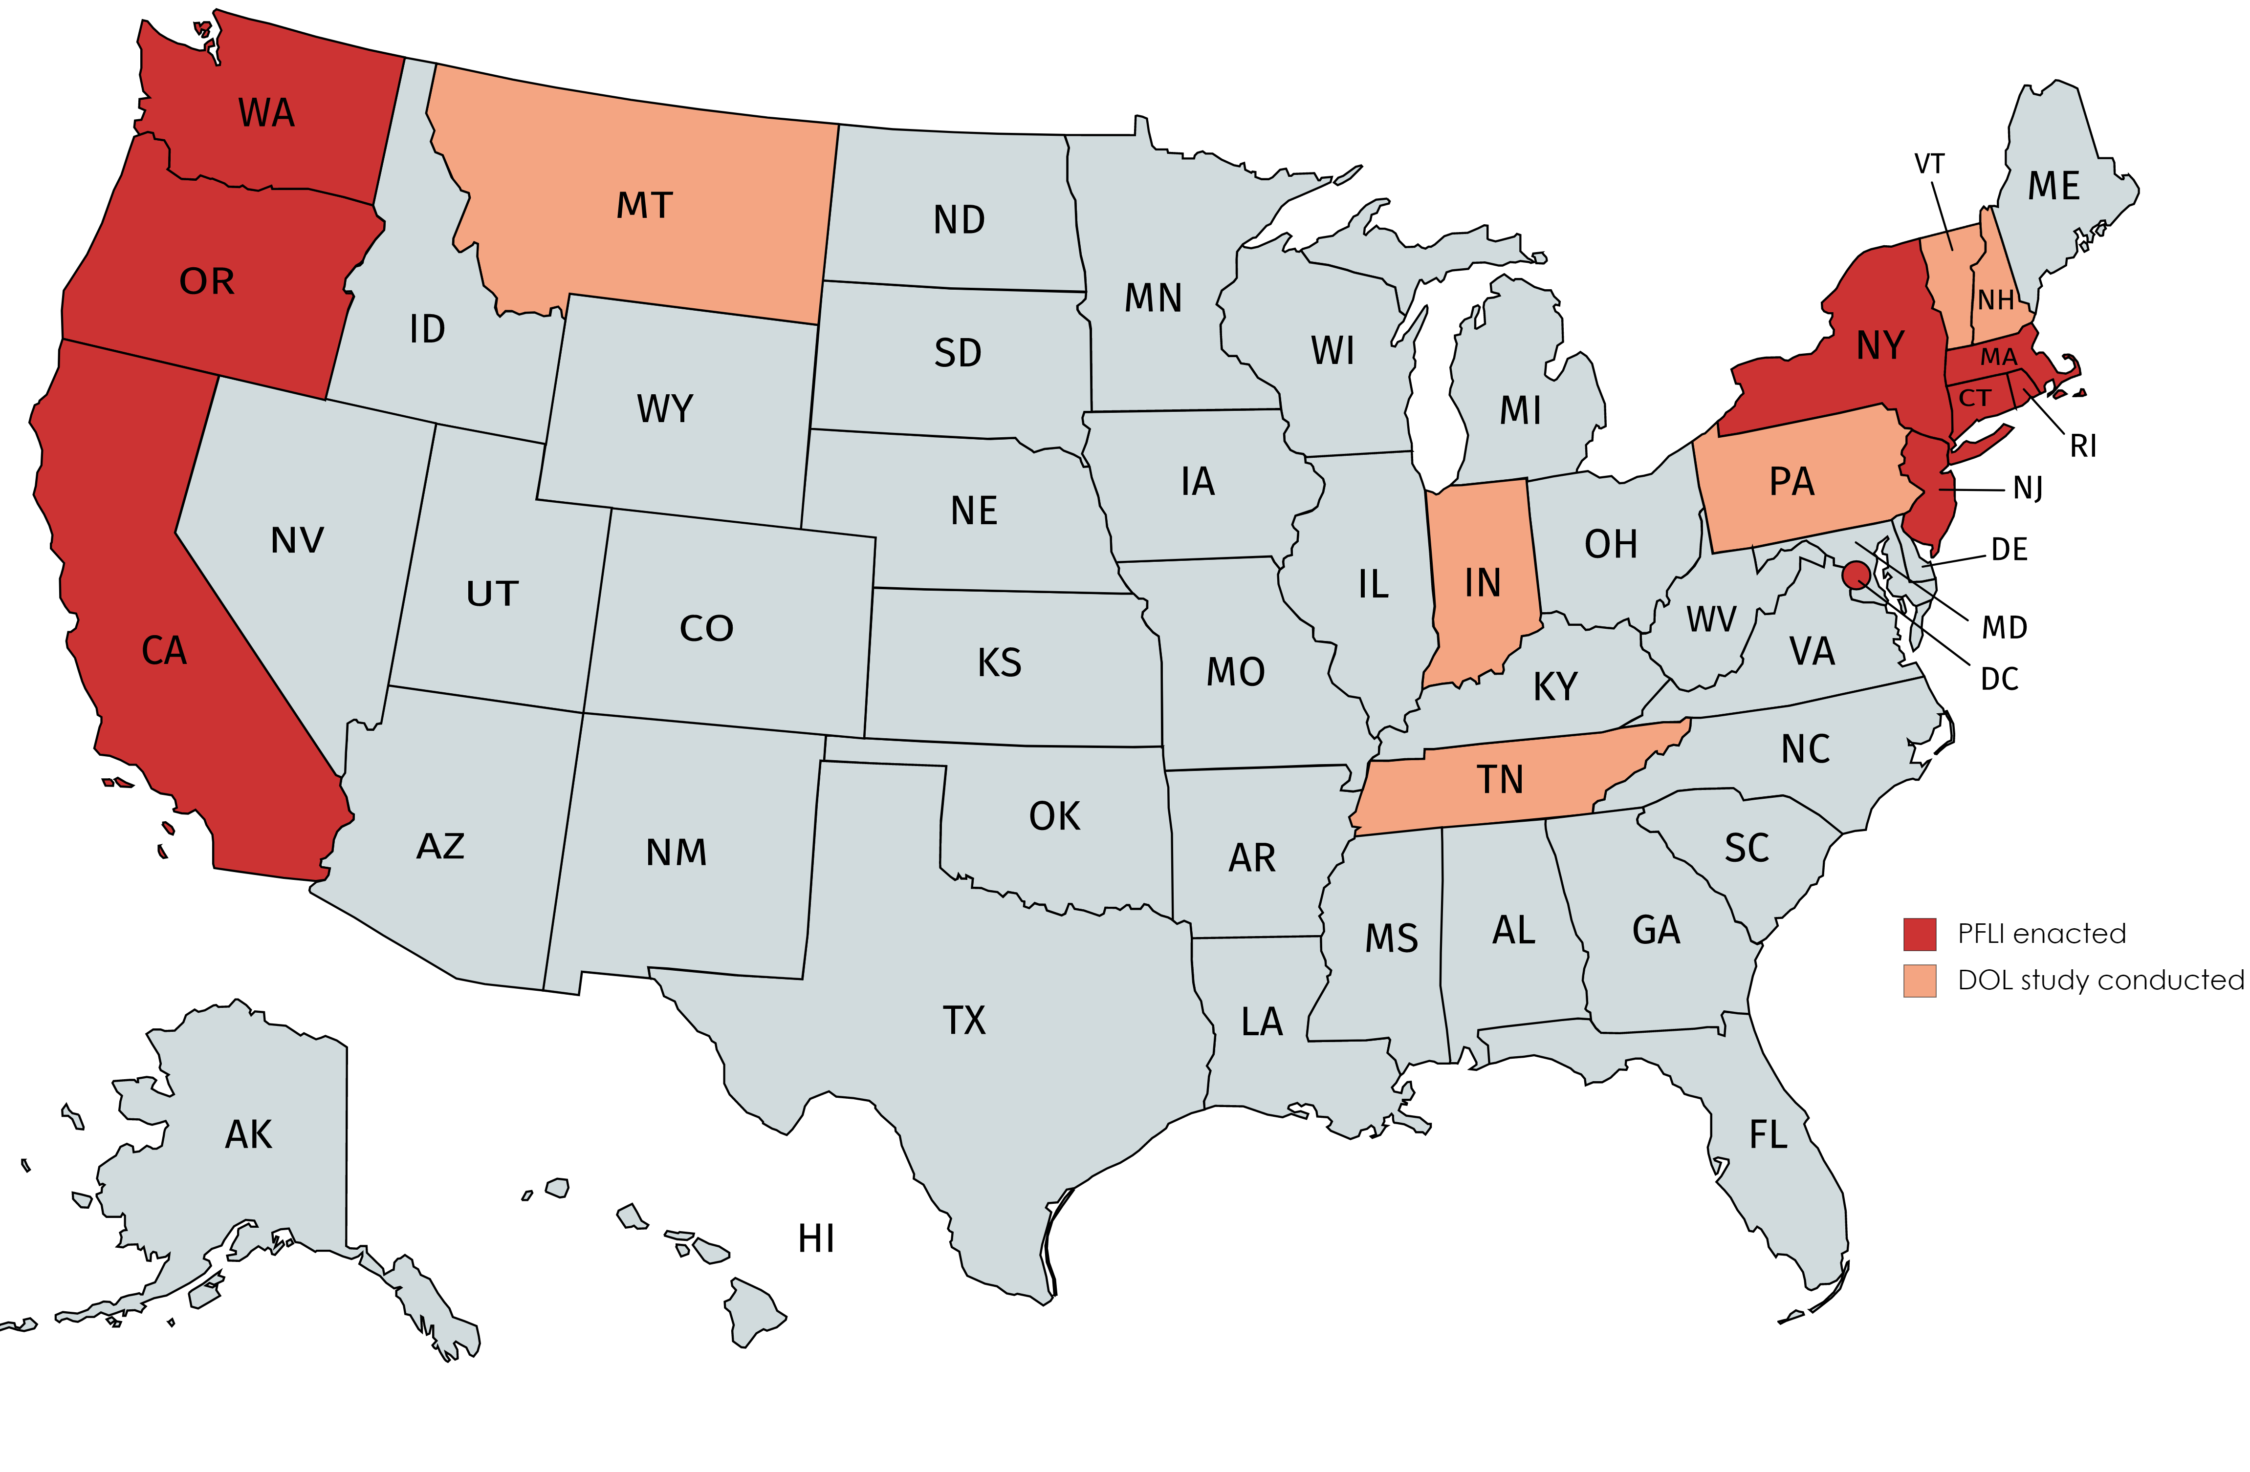
Existing Leave Programs
Eight states and DC have adopted Paid Family Leave Insurance (PFLI)
California (2004)
New Jersey (2009)
Rhode Island (2014)
New York (2018)
Washington (2020)
DC (2020)
Massachusetts (2021)
Connecticut (2022)
Oregon (2023)
Notes:
Components of PFLI: TDI (own medical leave) and FLI (new child or sick relative)
Two additional states on this list since the report was published in March of this year.

Slide 7

Components of a Statewide Paid Leave Policy
Employee contribution
Eligibility
Covered events
Duration of leave
Wage replacement = pay while on leave
Cap on benefits
Waiting period
Take-up rate
Importance: These variables influence cost and benefits

Slide 8
Simulating Two PFLI Proposals for NC
 | Proposal A | Proposal B
Maximum Duration of Leave | 8 weeks | 12 weeks
Amount of Benefit | 55% of wages up to weekly max | 80% of wages up to weekly max
Maximum Weekly Benefit | $486 | $875
Wage Base for Premium | Up to $25,292 | Up to $45,526
Waiting Period | One week | No waiting period
Eligibility | Worked at least 80 hours in the last year At least $1,560 total earnings in last year | Worked at least 80 hours in the last year At least $1,560 total earnings in last year
Notes:
Point to Brookings-AEI study - bi-partisan working paper as well as what other states are doing.

Slide 9

Two Simulation Methods
Model 1
Modifies a model created by the Montana Budget and Policy Center in 2015
Model 2
Uses the Albelda Clayton-Matthews/ IWPR 2017 Simulator Model (University of Massachusetts-Boston)
Notes:
Both models rely on census data and assumptions about program take-up.
Both were funded by department of labor grants to research the costs and benefits of PFLI.

Slide 10
Estimated Participation
 | Proposal A |  | Proposal B
 | Model 1 | Model 2 | Model 1 | Model 2
Covered employees per year | 4.7m | 4.8m | 4.7m | 4.8m
Number of covered employees taking PFLI leave per year | 193,389 | 229,483 | 193,389 | 277,744
Average weekly PFLI benefits paid to employees taking PFLI leave | $335 | $330 | $537 | $520
Total amount of PFLI benefits paid to all PFLI leave takers PY | $360m | $497m | $865m | $1,157m
Notes:
We also looked at administrative costs:

Slide 11
Estimated Costs
 | Proposal A |  | Proposal B
 | Model 1 | Model 2 | Model 1 | Model 2
Employee premium as a % of earnings per year | 0.35% | 0.54% | 0.58% | 0.89%
Average weekly premium cost per worker | $1.47 | $1.97 | $3.52 | $4.59
Notes:
We also looked at administrative costs:

Slide 12
Impact on Infant Mortality
26 infant lives in North Carolina would be saved per year under a PFLI proposal that simulates a statewide 12-week paid leave policy with 80% wage replacement.
Saving 26 infant lives would reduce the North Carolina infant mortality rate to 7.1 per 1,000 from 7.3 per 1,000.
Notes:
· Twenty-six infant lives in North Carolina would be saved per year, among other benefits, under the PFLI proposal that simulates a statewide 12-week paid leave model with 80 percent wage replacement. Saving 26 infant lives would reduce the North Carolina infant mortality rate to 7.1 per 1,000, from its 7.3 per 1,000, which was the rate in 2018 – the year for which complete data was available at the time of this study.

Slide 13
Impact on Infant Low Birth Weight
Our simulations show that a statewide 12-week PFLI policy with 80% wage replacement would reduce the number of infants born low birth weight by 776 infants.
Because low-birthweight infants require more medical care than infant born at normal birthweight, between $2 million and $11.7 million would be saved.
Notes:
· Twenty-six infant lives in North Carolina would be saved per year, among other benefits, under the PFLI proposal that simulates a statewide 12-week paid leave model with 80 percent wage replacement. Saving 26 infant lives would reduce the North Carolina infant mortality rate to 7.1 per 1,000, from its 7.3 per 1,000, which was the rate in 2018 – the year for which complete data was available at the time of this study.

Slide 14
Other impacts on Families and Workers
Reduced nursing home usage
Reduced use of government assistance
Improved workforce and health outcomes
No evidence of negative impact on employers

Slide 15
Thank you!
Collaborators:
Elizabeth Ananat, Ph.D., Barnard College
Hadeel Abdelhy, BA
Mary Edgerton, MPP
Kristen Jensen, MPP
Josie Link, MPP
Pooja Rao, MPP
Melissa Roark, MPP
Eliza Salmon, MPP
Sarah Vanderbilt, MPP
Jessica Wilkinson, MPP
Anna Gassman-Pines, Ph.D.
agassman.pines@duke.edu
(919) 613-7301
Full study link: Duke paid leave study

