Slide 1
Family Forward NC is an initiative of the North Carolina Early Childhood Foundation.
Notes:
Today we are going to talk about family friendly workplace benefits and their positive impact on the workplace and family. Let’s start by asking what does a family friendly workplace mean to you?

Slide 2
The North Carolina Early Childhood Foundation is driven by a bold vision.
Each North Carolina child has a strong foundation for lifelong health, education and well-being supported by a premiere birth-to-age-eight system.
Our Mission
To marshal North Carolina’s great people, ideas and achievements to build a foundation of opportunity and success for every child by the end of third grade.
Notes:
Good morning.
I’ll start with a brief overview of my organization. We are a statewide organization with a bold vision for each NC child to have a strong foundation for lifelong health, education and well-being supported by a premiere B-8 system.
And we can realize the vision working with people like you.
In a minute I’ll tell you more about why the B-8 years are so important.

Slide 3
Unleashing potential
When each child is given the best opportunity to succeed—to realize their potential and to productively contribute to society—North Carolina prospers.
Notes:
Today we’ll talk about unleashing the potential of our youngest residents and how that can transform NC and our country.

Slide 4
✓ Single-Digit Unemployment Rate
Double-Digit Skills Gap
✓ Student’s Low-Reading Proficiency
What does that have to do with workforce and economic development?
Family friendly workplaces deliver an immediate payoff and long-term gains.
Notes:
By now you are probably wondering if you are at the right conference – wondering what does that have to do with economic development?
Today I am going to show how providing greater access to family friendly workplace benefits deliver a return for business, employees and children, fueling the economy and unleashing the potential of our future workforce.
With single digit unemployment, double digit skills gap and low reading proficiency in our young children, it’s urgent.

Slide 5
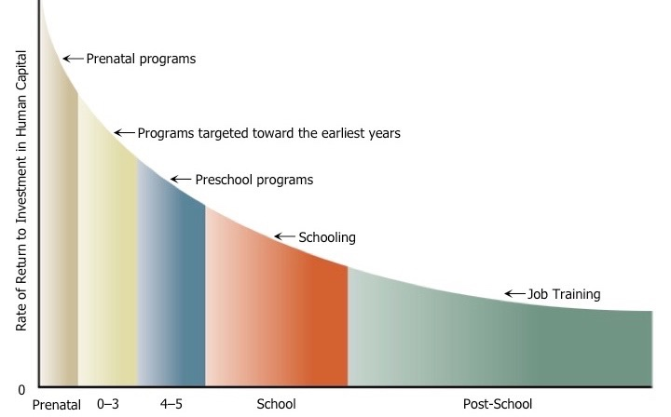
Human capital creates economic capital.
“The foundation for school, career and life success is largely determined through the development of cognitive and character skills beginning in children’s earliest years.”
13% ROI
Nobel Laureate Professor James Heckman
Notes:
This graph show why we start the conversation with early childhood.

Slide 6
“American business depends on a strong workforce, now and in the future, to compete and succeed globally. But America is facing an unprecedented workforce crisis: a large and growing shortage of skilled workers.
One root of this problem is that we’ve underestimated the importance of the earliest years of life.”
— US Chamber of Commerce Foundation
Notes:
The US Chamber of Commerce said this in 2010 and continues to recognize the relationship between ECE and the growing skills gap. SO do NC business leaders.

Slide 7
67%
45.9%
of jobs in NC will require some post-secondary education by 2020
North Carolinians with that level of education today
36%
36%
of NC high school students met ACT college readiness benchmarks in reading in 2017
of NC 4th graders in 2019 scored below proficient in reading as measured by NAEP
Notes:
The data is telling and NC is not out of the ordinary.

Slide 8
Addressing these challenges and increasing reading proficiency requires that we begin here.
Notes:
So let’s start at the beginning.

Slide 9
Why birth to eight?
The most rapid period of development in human life happens from birth to eight.
End of third grade outcomes predict academic achievement and career success.
Notes:
This is why our focus is on the first 8 years of a child’s life.

Slide 10
Brains are built, not born.
Early experiences are built into children’s bodies—shaping brain architecture and impacting how biological systems develop.
Every experience a baby has forms a neural connection in the brain at a rate of more than a million synapses per second in the early years.
Not all will last. Connections that get used more strengthen, and those used less fade.
Positive early experiences build a strong foundation for learning and future health.
Notes:
Let’s take a look at what is happening during these early years. Every childhood experience forms a neural connection in the brain. These connections—called synapses—form very rapidly in the early years – one million per second. And then those that are not used are shed.
Synapses are what connect brain cells. They form a network in the brain. This network influences everything from intellectual capacity to problem solving to language.
How that wiring is formed, either as a strong or weak foundation depends on that child’s interactions with the world around him or her. Genes are only part of the equation.
Only a few years ago brain scientists believed the rate of neural connections forming was 700,000 and now it’s one million!

Slide 11
More than academics
As essential as they are, we aren’t born with the skills that enable us to control impulses, make plans, and stay focused. We are born with the potential to develop these capacities.
Notes:
We tend to talk a lot about academic skills. Yet social and emotional skills are just as important—and some say more important.
Being able to focus, hold, and work with information in mind, filter distractions, and switch gears is like having an air traffic control system at a busy airport to manage the arrivals and departures of dozens of planes on multiple runways.
Acquiring the early building blocks of these skills is one of the most important and challenging tasks of the early childhood years.
A survey of business leaders found that employers view these “soft” skills as even more important to work readiness than traditional skills like reading, writing and math.

Slide 12
The good news - it’s achievable
Each child can have the opportunity to be on track by third grade with aligned state and local policies and practices rooted in child development, including:
Health and Development on Track, Starting at Birth
Supported and Supportive Families and Communities
High Quality Birth-Through-Age-Eight Learning Environments with Regular Attendance
Notes:
Here’s the best part – we know what works! We know what children need for a strong foundation, and we know the policies and interventions that can help ensure that all children have the opportunity to fulfill their potential.
These three broad areas were agreed upon through our initiative – Pathways to Grade-Level Reading – where we convened partners and experts to agree on not only these topline goals but also a Framework for Success and Action.
The benefits are long lasting – from reduced child abuse and neglect, higher K readiness, increased reading and math proficiency and higher graduation rates. So early childhood investments are investments in the American economy and our future competitiveness through workforce readiness.

Slide 13
Innovative, business-led
Family Forward NC is an innovative initiative to improve children’s health and well-being and keep North Carolina’s businesses competitive.
It is business-led change to increase access to research-based, family-friendly practices—big and small—that increase workplace productivity, recruitment and retention; grow a strong economy; and support children’s healthy development.

Slide 14
68.9% of households include two parents
9% of all families have one parent who cares for children full time
Families Have Changed
Notes:
68.9% of households include two parents
9% of all families have one parent who cares for children full time
Why family friendly benefits?
The American family has changed and in many respects, the workplace hasn’t.
So why and how should employers focus on supporting parents?
Family friendly workplace benefits deliver a return for employers, employees and children.
* Data from the Institute for Family Studies.

Slide 15
In 2016, two million parents of children age five and younger had to quit a job, not take a job, or greatly change their job because of problems with child care. In North Carolina the number was 62,873.
Two million
Nearly 40% of parents nationwide say they’ve left a job because it lacked flexibility.
40%
75%
of moms
40%
of parent
According to the Federal Reserve in San Francisco, there would be 5 million more workers in the US workforce if parents had access to more family-friendly benefits.
Five million
Notes:
Let’s look a little deeper at our workforce.
The challenges of working parents that do not have access to family friendly benefits are real.
We are losing workers.

Slide 16
Family-friendly benefits are good for business, good for our children and good for the health of our future workforce.
Offering family-friendly workplace benefits is a win-win-win.
Notes:
Business Smart: Businesses that offer family-friendly benefits are more likely to attract top talent, retain their current employees and have a productive, loyal workforce.
Family Friendly: Increasingly, working parents consider family-friendly offerings a priority when it comes to choosing or staying in a job.
Future Ready: And workplaces that support parents have a direct impact on their children’s health, well-being, and future academic and career achievement.

Slide 17
Since 2018, we have…
Talked to more than 4,700 employers and employees across North Carolina.
Conducted a research review to identify family-friendly workplace benefits with positive outcomes for employers, parents and children.
Created an Advisory Council of business leaders and community and health organizations.
Published the Guide to Family Forward Workplaces accompanied by a website.
Hosted the Family Forward NC Summit for businesses and nonprofit leaders to explore ways to include family-friendly practices in their own workplaces.
Published 27 case studies about NC employers.
Notes:
Go back and tell you a bit about how our initiative started.

Slide 18
Of employees say that offering family-friendly practices and benefits give employers a competitive edge.
Nearly 3 in 4
NC employees would be more committed to their employer if more family-friendly benefits were offered.
94%
Of NC employers believe family-friendly practices have a positive impact within their own organization.
71%
Notes:
This is from the research conducted for FFNC by an external firm.
So there’s a recognition of the benefits of FF workplace policies.

Slide 19
Family-friendly is more than paid leave.
Big and small changes offer research-based, positive business benefits and health outcomes for children and families. Employers of all sizes can find ways to incorporate family-friendly practices.
We’ve identified 16 benefits with positive outcomes for employers, parents and children in five categories:
Paid Leave
Flexible Work and Scheduling
Health and Wellness Benefits
Childcare
Accommodations and Support
Notes:
That’s not to say paid leave isn’t important. It is. Paid parental leave increases employee retention, is one of the best ways to attract top talent (especially millennials), and improves workplace productivity (and not just for moms – for all employees). Paid leave also leads to lower infant mortality rates, lower chances for maternal depression and increased father engagement, which is important both for dads and for the short and long-term health of their children.
But even if an employer can’t offer paid leave, they can incorporate other benefits.
We’ve identified 16 in 5 buckets. Outlined in the Guide.

Slide 20
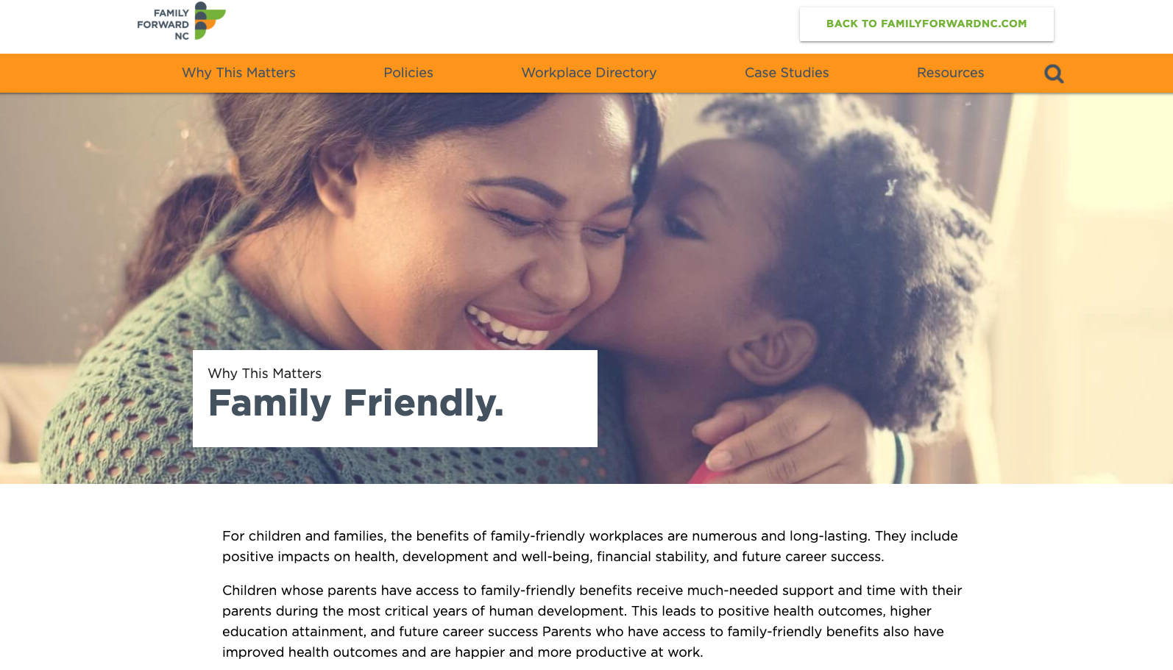
www.familyforwardnc.com/guide
Notes:
Definitions, Benefits, Best practices, Case studies, Getting Started
I am going to share one benefit from 3 of the 5 categories.

Slide 21
Workplace Policies that Deliver Results
Paid Leave
Parental leave
Sick and safe leave
Family and medical leave
Results
Increases productivity, recruitment and retention
Reduces infant mortality
Increases educational attainment
Decreases maternal depression
Increases paternal involvement in caregiving
The United States is the only developed nation in the world with no national paid parental leave policy.
Notes:
The United States is the only developed nation in the world and one of only a small handful of countries with no national paid parental leave policy. The other countries are Papua New Guinea, Suriname, and a few small South Pacific island countries.
The number of employers offering paid leave has grown steadily over the past decade, but still, only 16 percent of private industry workers had access to paid parental leave in 2018, according to the Bureau of Labor Statistics.

Slide 22
Workplace Policies that Deliver Results
Flexible Work and Scheduling
Flextime
Working from home/telecommuting
Job sharing and/or part-time work
Predictable scheduling
Results
Increases productivity, recruitment and retention
Reduces absenteeism
Reduces childhood obesity
Reduces stress and increases job satisfaction
Nearly 40% of parents nationwide say they’ve left a job because it lacked flexibility.
Notes:
Nearly 40 percent of parents nationwide say they’ve left a job because it lacked flexibility.
In North Carolina, about eight in ten of all employees see flexible work hours and schedules as an important family-friendly practice.

Slide 23
Workplace Policies that Deliver Results
Child Care
Backup or emergency care
On-site or consortium sponsored care
Subsidized/Reimbursed care or childcare referral
Results
Improves productivity and increases recruitment, retention
Reduces absenteeism
Improves high school graduation rates, overall educational attainment
Improves family economic security
99 of 100 counties in North Carolina are child care deserts.
Notes:
In North Carolina, child care accounts for 27 percent of basic living expenses for families – more than food, housing, transportation or health care costs.
99 counties in NC qualify as child care deserts, or counties where there are three or more children for each licensed child care slot.

Slide 24
Business Smart: Mitchell Gold + Bob Williams
Alexander County 900+ employees
Child Care
On-site sponsored care
Health and Wellness
On-site health center for employees and families
Notes:
Alexander County – Taylorsville
250 employees.

Slide 25
Business Smart: Raydal Hospitality
Charlotte, 230 employees
Paid Leave
Paid time off
Flexible Work and Scheduling
Flextime
Predictable schedules
Health and Wellness
Health, vision and dental insurance
Notes:
Alexander County – Taylorsville
250 employees.

Slide 26
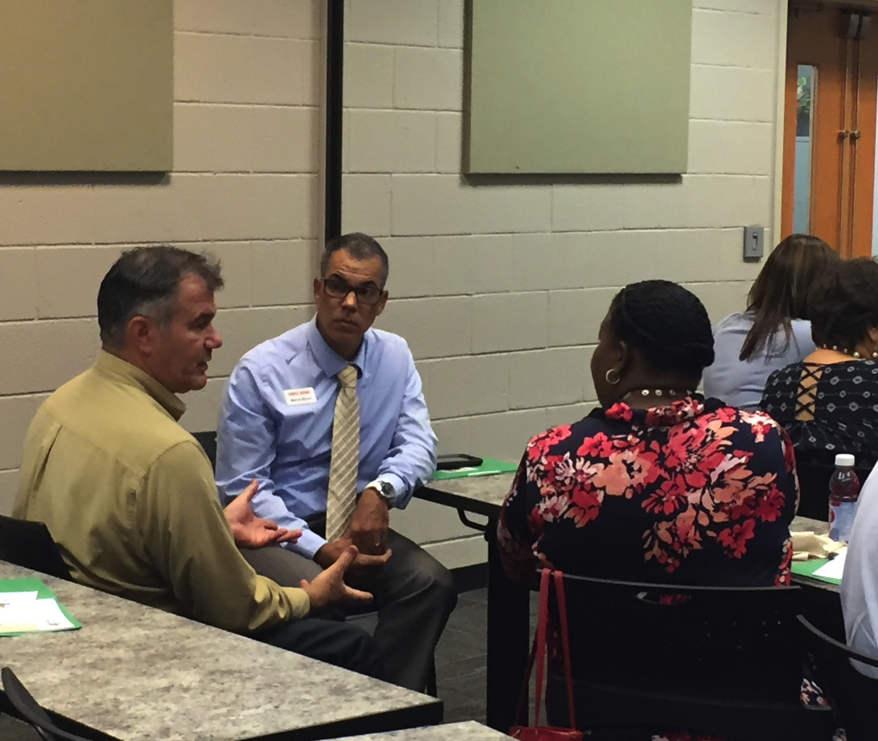
2020 Opportunity
Family Forward NC will establish five cohorts across NC to provide concentrated support to motivated employers to add industry-appropriate family-friendly policies to their workplaces.
Focus is on tourism jobs and manufacturing, specifically in the furniture and textile industries.
Notes:
Since 2018, we’ve spoken to nearly 5000 business leader and understand the lay of the land on family friendly workplaces in. Many small and medium sized businesses lack HR staff and expertise to make change. That’s why In 2020 we will form cohorts of motivated employers in the same geographic area and similar industries to provide concentrated support to add industry-appropriate family-friendly policies to their workplaces.
We will provide the necessary consultants.
Contact me if you are interested.

Slide 27
Questions?
Share your family friendly workplace policies and practices for recognition and a case study.
Sign up for our twice monthly e-newsletter
www.familyforwardnc.com
#familyforwardnc
Notes:
Sign up for our twice monthly newsletter

