Slide 1
Challenges to Improving Care for Patients with Serious Illness
NICIOM Serious Illness Workgroup
August 9, 2019
Lynn Hill Spragens, MBA
Lynn@Spragensgr.com
Spragens & Associates, LLC Durham, NC
www.spragensgr.com

Slide 2
Overview of Themes in draft Recommendations
Simplify/ remove burdens
Reliability & consistency (access to records)
ACP focus (good start…)
Training (re ACP’s & legal, communication)
Innovation – Teams, Telehealth, payment
Caregiver needs
Public education

Slide 3
Desirable Characteristics for Recommendations
“Do no harm” (consider the unintended consequences or “gaming” risks)
Likelihood of promoting collaborative solutions vs. more “silos”
Right thing to do is also most simple…
Generalizability across economic/insurance lines (to reduce complexity for delivery systems)
Ways for the work to be an intervention (taskforces)

Slide 4
Challenges for Consideration
“Rear view mirror” data – challenges identifying people and needs prospectively (macro vs. micro perspectives)
Medical care, health care, and social/financial support systems are managed (and funded) in silos.
Macro design often does not simplify direct care delivery.
Mandates & quality measures intended to set a floor to performance; often become a ceiling.
“Serious Illness” is rarely “one thing”
ACP (Advance Care Planning) $≠$ Effective ongoing Communication

Slide 5
Rear View Mirror: The Denominator Challenge
Current identification (algorithms) often rely on inadequate administrative data
Results include under recognition of many and over attention to some
Mismatch can dilute impact and raise costs
Identifying the Population with Serious Illness: The “Denominator” Challenge Amy S. Kelley and Evan Bollens-Lund Journal of Palliative Medicine 2018 21:S2, S-7-S-16

Slide 6
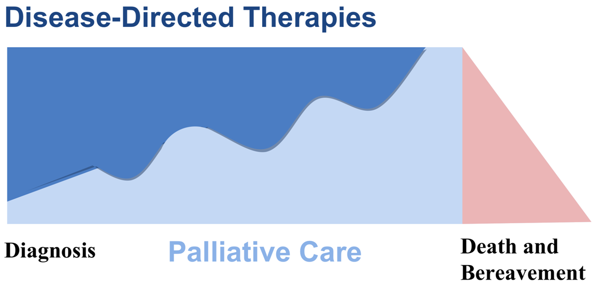
Palliative Care is Delivered Concurrent with Disease Treatment
Need for ongoing effective communication & flexed resources
Core competencies in palliative care
6

Slide 7
Dilemma: Alignment of design, investment, & benefit
Patient & Family Experience
Medical
Community
Medical Care & Costs
Insurance
Providers
Specific Entity Budgets
Hospital
Ancillaries
Out of pocket
Prof Practice
Caregiver
SNF, Home Care other

Slide 8
Think outside the box…
“Why do we continue trying to make great health care out of disconnected, separately perfected fragments instead of weaving the fabric of experience that our patients need from us?”**
**Don Berwick, Escape Fire Designs for the Future of Health Care 2004, preface xi

Slide 9
Financial Realities
Best care for complex patients is unlikely to be fully funded by FFS norms
It is likely to be cost-effective “in the big picture” but costly in the small picture (drives direct costs and diffused benefits)
Even risk bearing orgs like ACOs have difficulty reallocating costs.

