Slide 1
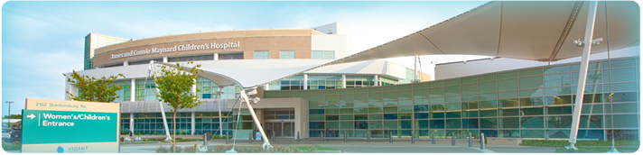
Making Eastern North Carolina a Better Place to be Born
Angela T. Still, MSN RN
Administrator
Women’s Services
Vidant Medical Center

Slide 2
North Carolina Perinatal Outreach Program
Prior to 2009, Perinatal and Neonatal Outreach existed through AHEC and the NC DHHS, Division of Maternal Health, Women’s and Children’s branch
Funded by the State of NC until funding was cut
PALS Phone Line
Focused on regional initiatives to impact infant mortality such as:
    Folic Acid Campaign
    STD screening
    Continuing education activities
    Faculty resource to university and community colleges
    Worked closely with DHHS regional nurse consultants
    Maintained lending library
    Participated in local, regional and state committees related to
    perinatal health

Slide 3
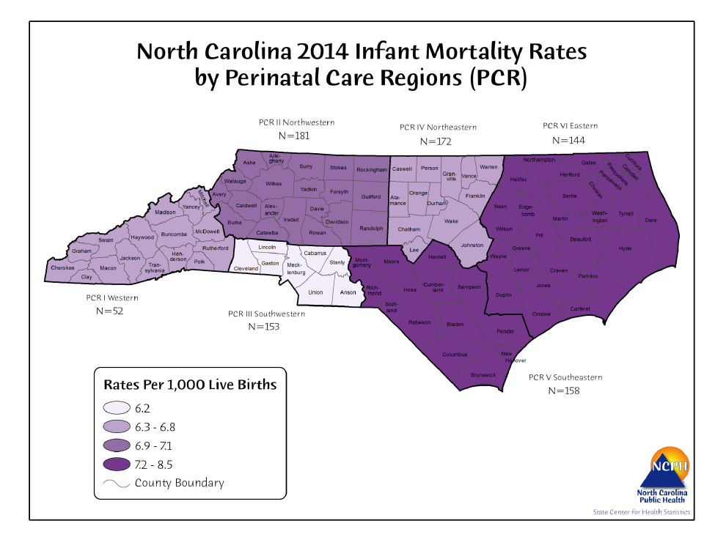
Perinatal Region VI

Slide 4
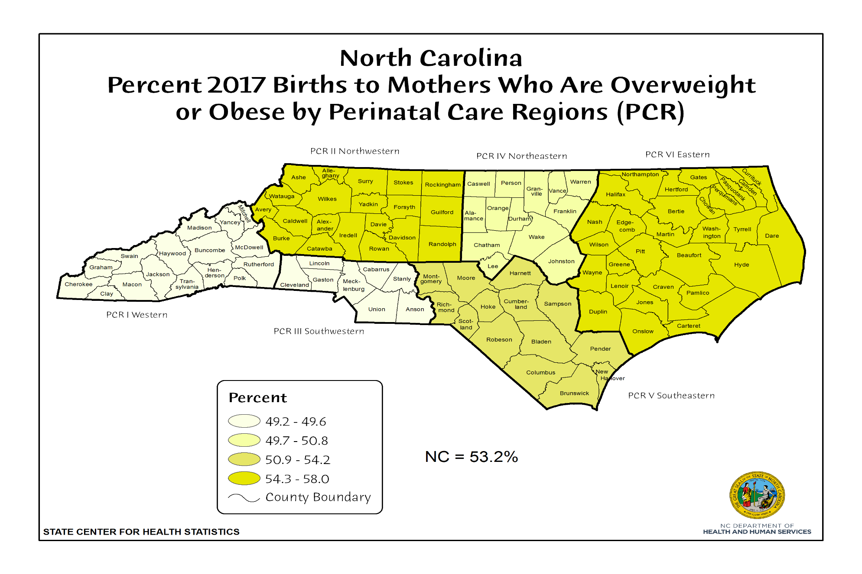
Obesity

Slide 5
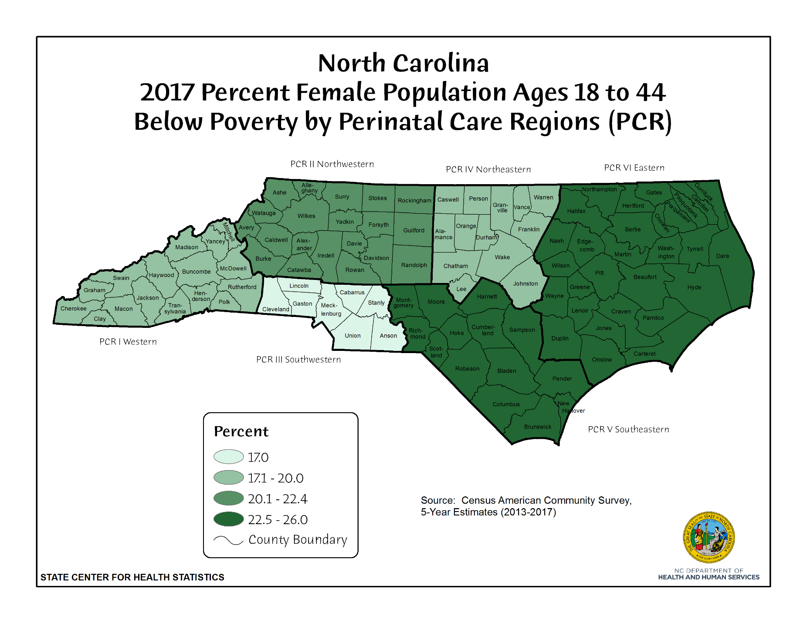
Poverty

Slide 6
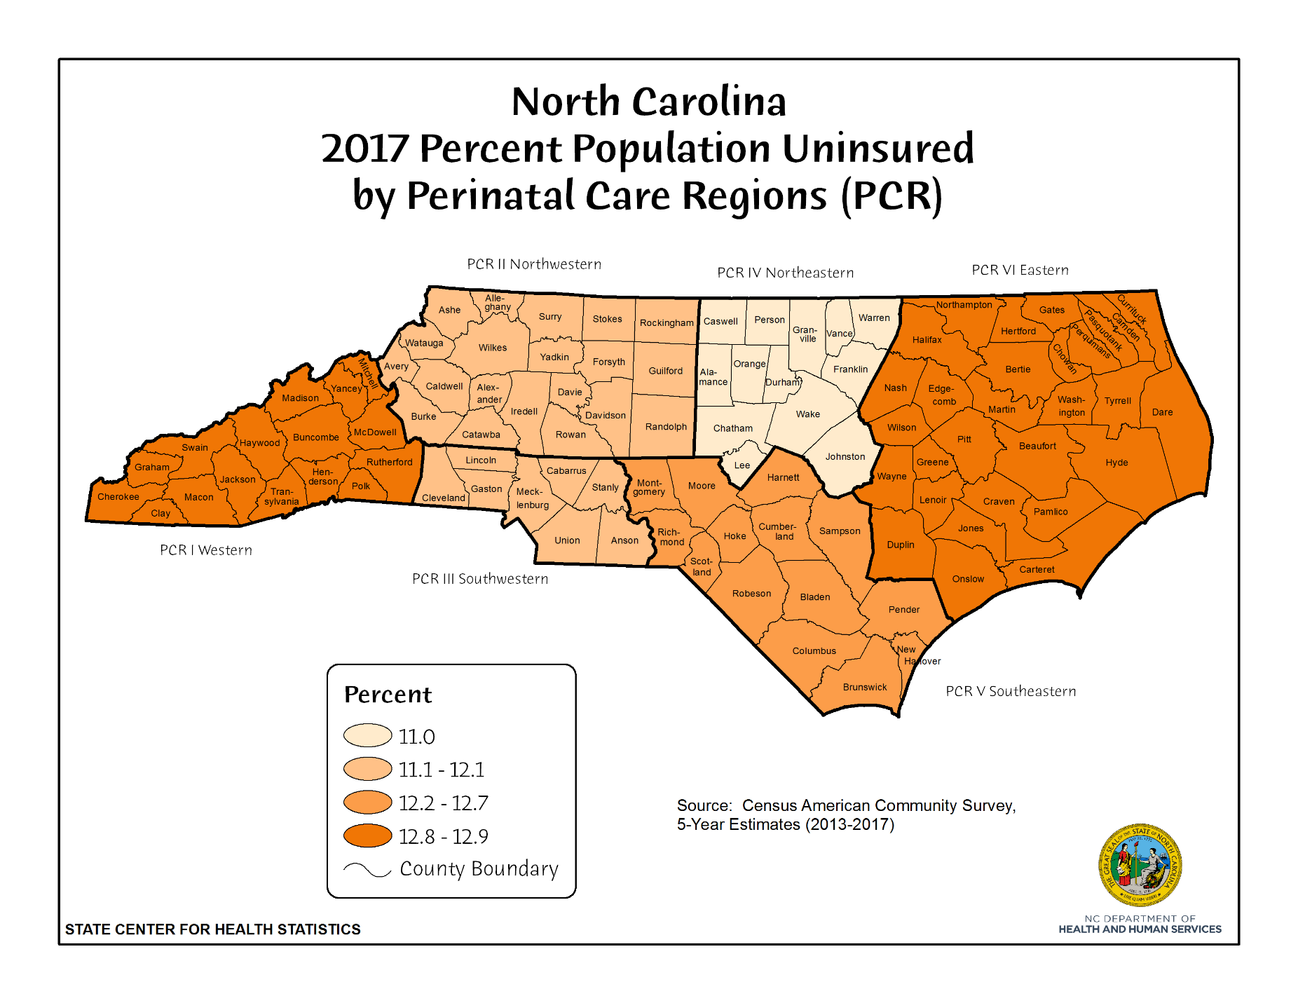
Uninsured

Slide 7
Vidant Perinatal Outreach - Began in January 2012
Mission Statement
The mission of the Perinatal/Neonatal Outreach is to coordinate comprehensive perinatal and neonatal evidenced based care and education to all community hospitals throughout the 29 counties of Eastern North Carolina.
As care practices are modified to align with current evidence based initiatives, support is provided to both inpatient and outpatient locations to optimize care for perinatal and newborn patients.

Slide 8
Vidant Perinatal Outreach Focus
Vidant Community Hospitals and their providers were initial focus, however Perinatal Outreach also provides education and assistance to hospitals who provide obstetrical services in the 29 county region.
  Perinatal Outreach staff are instrumental in the operation of the Women’s Vidant Coordinating Group, which meets bi-monthly.
  This team also facilitates a Regional OB Manager meeting twice a year which includes representation from each hospital in the 29 county region that deliver babies.

Slide 9
“Boots on the Ground”
  Perinatal Outreach Coordinators
      Kimberly Harper, MSN MPH RN 2012-2015
      Kathryn Mitchell, MSN CNM RN 2016-present
      Jennifer Kendrick, MSN candidate, BSN RN 2018-present
  Neonatal Outreach Coordinator Robin Raynor, MSN RN
  Perinatal Case Manager Dawn Daniels, BSN RN 2012-2018
  Medical Directors
      Dr. Jim deVente, PhD, MD Obstetrics
      Dr. Ryan Moore, MD Neonatology
  Administrator Angela Still, MSN RN

Slide 10
Care in Perinatal Region VI
29 counties in rural eastern North Carolina
20 hospitals, only 18 provide obstetrical services
  7 Vidant Community Hospitals – 6 provide OB services
  13 Community Hospitals – 12 provide OB services
Vidant Medical Center- Tertiary Care Center
  Two Maternal Fetal Medicine Specialists
  Regional Perinatal Center at ECU Brody School of Medicine
  50 Bed NICU and 21 Bed Special Care Nursery

Slide 11
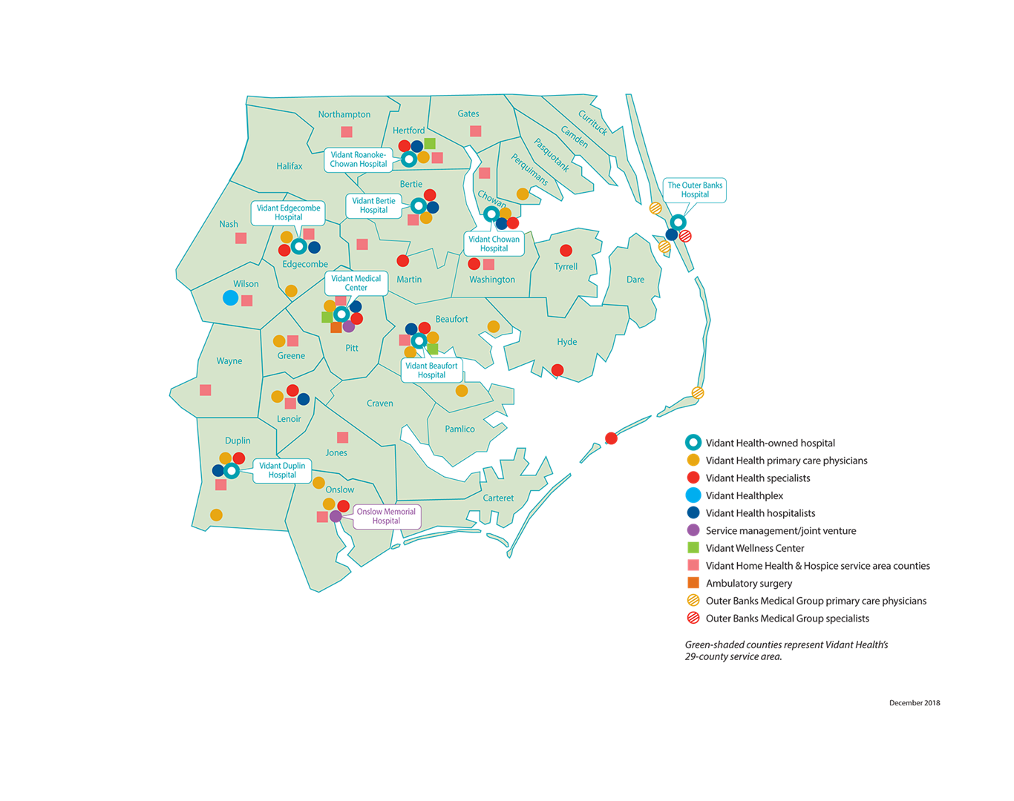
Perinatal Region VI Facilities

Slide 12
Assessment and Plan
Needs Assessment at Vidant Community Hospitals
  Evidenced Based Practice
  Equipment
  Staff Competency
  Provider resources and coverage
  Multidisciplinary collaboration
Case Management of high risk OB patients- referrals and communication with providers
Develop Action Plan
Expand work to regional non-Vidant hospitals

Slide 13
Strategies are Multidisciplinary
Site consultations
Education and Certification Programs onsite
Simulations/Drills and Team Building on the nursing units, e.g.:
  Ob hemorrhage, shoulder dystocia, obstetrical emergencies, preterm delivery, forceps, etc..
Practice changes such as conservative management of pre-eclampsia, post-partum hemorrhage, newborn antibiotic stewardship, etc.

Slide 14
Strategies continued…..
Assist providers with maternal consults at clinic or transfers to tertiary center for appropriate level of care
Participate in local and state collaboratives and task forces
2018- Received Perinatal/Neonatal Outreach Coordinator Grant: LARC and LOCATe - initiated work in the region to implement
Partner with Vidant Physician Outreach
  Networking with providers in region
  Resolution of identified issues

Slide 15
2018 Perinatal Outreach Overview
Consultative Site Visits:16
  Vidant facilities: 7 (including Vidant Bertie ED)
  Non-Vidant facilities: 9
Local and State Collaboratives, e.g.:
  Perinatal Quality Collaborative of NC (PQCNC)
  NC AWHONN Board of Directors
  PIMPAC (Pitt Infant Mortality Prevention Advisory Council)
Perinatal/Neonatal Outreach Program Grant
  CDC LOCATe Evaluation
  Increase access to IPP LARC

Slide 16
2018 Perinatal Outreach Overview
Perinatal/Neonatal Outreach Educational Programs:
11 Programs with 162 offerings and 1,386 attendees
Advanced Life Support for Obstetrics (ALSO): 12 courses; 144 attendees
AWHONN Intermediate Electronic Fetal Monitoring : 27 courses; 160 attendees
AWHONN Advanced Electronic Fetal Monitoring: 3 courses; 18 attendees
Advanced Cardiac Life Support (ACLS): 10 courses; 60 attendees
The Heart in OB: 10 courses; 120 attendees
Cardiac STABLE: 10 courses; 100 attendees
STABLE: 35 courses; 280 attendees
Neonatal Respiratory Support & Surfactant Administration: 42 courses; 420 attendees
Neonatal Resuscitation for the Provider: 8 courses; 40 attendees
Labor Support Education for Labor/Delivery Staff: 2 courses; 20 attendees
Childbirth and Postpartum Professional Association (CAPPA) Certification Training Course: 3 courses; 24 attendees

Slide 17
2018 Perinatal Outreach Overview
Multidisciplinary Simulations on Nursing Units
13 facilities (2-3 per facility/year)
36 offerings; 540 attendees
    Postpartum hemorrhage with Bakri balloon insertion
    Preterm delivery with neonatal resuscitation
    Abruption with neonatal resuscitation
    Shoulder dystocia with neonatal resuscitation
    Eclamptic seizure
    Prolapsed cord with stat C-section and neonatal resuscitation
    Maternal resuscitation with neonatal resuscitation

Slide 18
Perinatal Outreach Grant Overview
Goal of Grant:
  Improve NC’s maternal & neonatal morbidity and mortality rates
LOCATe Facility Evaluations:
  All 18 facilities have completed
  2019 Grant team will deliver results and facilitate discussion
  on risk appropriate care for moms and babies in Region VI
IPP LARCs Access:
  VMC is the pilot facility to establish implementation plan to roll-out to the region.
  To date devices placed: 77 Mirena IUDs & 53 Nexplanon = 130 devices

Slide 19
In 2018 Perinatal Outreach…..
Logged over 36,000 miles equivalent to 1 ½ times around the globe
Instructed 198 educational offerings
Conducted 36 simulations
Completed 16 consultative site visits
Facilitated 1-2 electronic consults/queries per week regional OB managers
Exceeded year 1 grant metrics for LOCATe and LARC

Slide 20
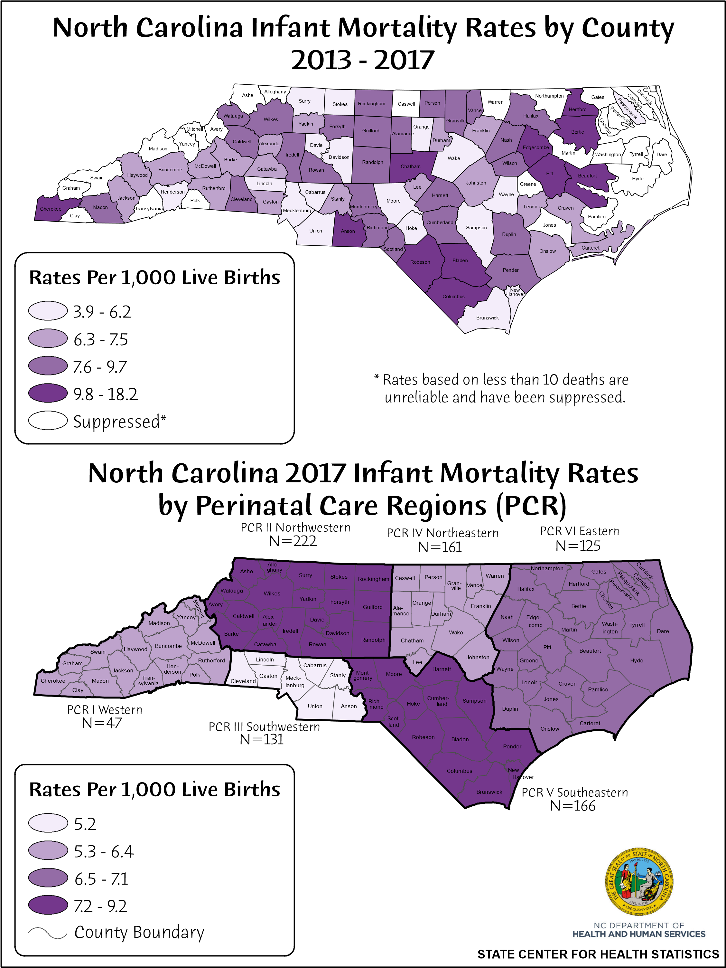
Infant Mortality 2017

Slide 21
Infant Mortality in Our Region, NC, and the USA
Eastern North Carolina’s Infant Mortality is for the first time in 20 years equal to that of the entire state!
Source: NCDHHS and CDC

Slide 22
Infant Mortality by Perinatal Region
p = 0.0051
At 17,500 live births per year in Perinatal Region VI
  175,000 live Birth for 10 years
With an Infant Mortality Rate of 9.1 per 1000 births
  1,592 infant deaths
With an Infant Mortality Rate of 7.9 per 1000 births
1,382 infant deaths
SO… what does this mean!
By improving Infant Mortality in Region VI we have prevented 210 infant deaths over 10 years
Therefore s preventing 21 infant deaths per year!
That is a kindergarten class per year!

Slide 23
Infant Mortality by Race Perinatal Region VI & NC

Slide 24
High-risk Undelivered OB Patients Transferred
Region VI Hospitals to VMC

Slide 25
Preterm Delivery Rate
14.8% decrease in infants born less than 37 weeks
40.7% decrease in infants born less than 32 weeks

Slide 26
Maternal Deaths 2015-2017
North Carolina & Perinatal Region VI

Slide 27
Fetal Deaths at VMC FY 2017-2018
Fetal Death Rate =
# fetal deaths > 20 weeks
# live births + # fetal deaths
X 1000
Fetal Death Rate =
73
7,344 + 73
X 1000
Fetal Death Rate =
9.8
Total Fetal Deaths = 119

Slide 28
Fetal Deaths (>20 weeks)

Slide 29
Fetal Deaths at VMC FY 2017-2018

Slide 30
Regional Perinatal Outreach Team
Teams travel to all obstetrical units in the region focusing on:
  Education – Fetal monitoring, ALSO, STABLE, etc.
  Evidenced based practice and team building through multidisciplinary simulation
  Lead Quality Initiatives – PQCNC, AIM, etc.
  Collaborate through regional meetings with unit leaders and providers
  Recognize and celebrate units with best practices
  Navigate logistics regarding EHR, Transfers, Transports, Communication, LARC and LOCATe, etc.
  Share outcomes
Include:
  Master’s prepared OB RN
  Master’s prepared Neonatal RN
  Obstetrician
  Neonatologist or Pediatrician
  Pharmacist Consultant

Slide 31










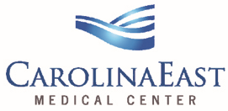














A few of our Partners
ALBEMARLE MEDICAL CENTER

