Slide 1
Communication Access to Health Care
American Sign Language (ASL)/English Interpreter Business Practices
NCIOM Task Force on Health Services for Individuals Who are Deaf and Hard of Hearing
April 5, 2019

Slide 2
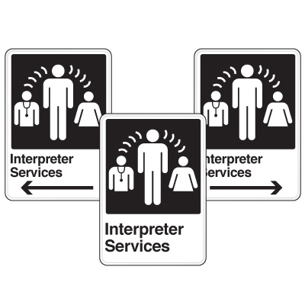
NC requirement for licensure
Provisional License
Graduation from an accredited interpreter training program: A.A.S. or B.A/B.S.
Minimum EIPA score of 3.0.
Full License
RID Certification

Slide 3
Standard ASL/English Interpreter Business Practices
Independent contractors
Service provider agencies
Self-employed
Responsible for all aspects of operating their own business.
Employees who work either full-time or part-time with all business aspects handled by their employer.

Slide 4
Interpreter Terms of Services
Rates
Travel Fees
Cancellation
Hourly rates (2 hour minimum)
Vary among individuals and agencies.
$50 to $70 per hour from individuals
$80 to $120 per hour from agencies
Mileage fees based on round trip miles multiplied by the federal rate, currently at $.58/mile
Sometimes travel time is charged at the hourly interpreting rate.
Policies vary from twenty-four (24) hours to two (2) weeks,
If assignment requires less time than scheduled or the assignment is cancelled upon arrival, the charges are generally for the time originally requested.

Slide 5
Provider Business Practices
Use of provisionally licensed interpreters;
Use of VRI only; and
Hospitals tend to contract with one interpreter service agency, which limits the pool of qualified interpreters.

Slide 6
Medical Interpreter Credentialing?
No standardized, accredited program/certificate for Sign Language Interpreters
RIT/NTID – non-credit “Certificate in Healthcare Interpreting”
HIPAA Compliance?
Interpreters are considered “business associates” who are assisting covered entities perform health care operations.

