Slide 1
A Study of the status of Risk Appropriate Maternal and Neonatal care in NC: Evidence based strategy to reduce infant mortality
ChargeTask Force: NC Session Law 2018-93
January 11, 2019
M. Kathryn Menard MD MPH
Vice Chair for Obstetrics Director of Maternal Fetal Medicine, UNC School of Medicine
Medical Director, NC Pregnancy Medical Home Program
Past President, Society for Maternal Fetal Medicine, 2012-13; PNC Obstetrics and Gynecologic Society,2017-18

Slide 2
Study levels of Maternal and neonatal risk Appropriate care: HB741 and SB 311
Child Fatality Task Force
Support a study bill to assess timely and equitable access to high quality risk-appropriate maternal and neonatal care; study to result in actionable recommendations.

Slide 3
North Carolina, 2014
66% of childhood deaths were infants
860 infant deaths
593 deaths within the first 28 days of life
187 due to prematurity and LBW
125 due to maternal factors/complications
These leading causes of neonatal death disproportionately affect minorities
Early and risk appropriate prenatal care can make a difference

Slide 4
3. Improve the quality of prenatal care
3C. Improve access to and utilization of first trimester prenatal care
3E. Ensure that all pregnant women and high-risk infants have access to the appropriate level of care through a well-established regional perinatal system
1. Decrease the % of VLBW and high-risk babies who are born at Level 1 and Level 2 hospitals
2. Define, identify and promote centers of excellence for VBAC (vaginal birth after cesarean)
3. Assess the levels of neonatal and maternity care services for hospitals using the consensus recommendations of the American Academy of Pediatrics (AAP), the American College of Obstetricians and Gynecologists (ACOG), and the Society for Maternal-Fetal Medicine (SMFM)

Slide 5
Risk appropriate Maternal and Neonatal care
Early onset prenatal care
Risk assessment and intervention for modifiable risk factors
Tobacco cessation
Optimal management of medical complications of pregnancy
Aspirin to prevent pre-eclampsia
17 hydroxyprogesterone to prevent recurrent preterm birth
Care management for those who will benefit most

Slide 6
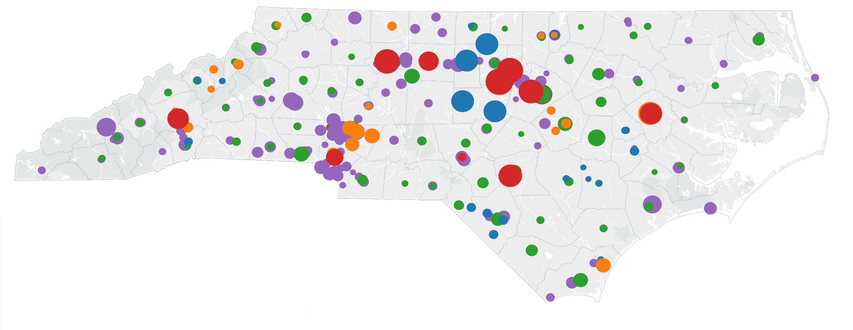
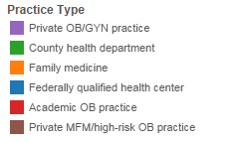
PMH Provider Network: Participation
Provider participation: 380 practices participate in the PMH program, representing >1,700 providers and more than 90% of maternity care provided to Medicaid patients. 95 of 100 NC counties have a PMH.

Slide 7
Early and risk appropriate prenatal care
Who is available to provide prenatal care?
What are they prepared to manage?
What is their capacity to see women in a timely manner?
What if more advanced care is needed? What is the system for referral? Do women accept referral?
Why do only 65% of Medicaid recipients receive prenatal care in the first trimester?
Rural counties: 69%
Metropolitan: 65%
Where are the service gaps? How can they be filled?

Slide 8
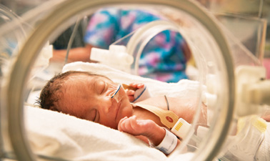
Risk appropriate Maternal and Neonatal care
When preterm delivery is inevitable
Antenatal steroids
Maternal transfer to hospital with
appropriate resources for neonatal care
VLBW newborns are 1.8X more likely to
die if born outside of a regional center
Lasswell, Barfield, Rochat, Blackmon. JAMA 2010

Slide 9
2012 AAP Levels of neonatal Care
Level I (Basic) | > 35 wks who are stable | Stabilize and transfer < 35 weeks
Level II (Specialty Care) | ≥32 wks or ≥1500 gms who have physiological immaturity | Provide convalescent care after intensive care; Assisted ventilation for ≤24 hours or CPAP
Level III (Subspecialty Care) | Continuous life support; Care <32 wks and <1500 gms | Advanced imaging w/ interpretation on an urgent basis (CT, MRI, echocardiography): Prompt access to full range of pediatric medical and surgical subspecialists on site or by pre-arranged consultative agreements
Level IV | See Level III | Capability to provide surgical repair of complex congenital or postnatal conditions; Immediate at-site access to pediatric subspecialists, pediatric surgeons and pediatric anesthesiologists

Slide 10
Are North Carolina’ highest risk infants born in facilities with resources to provide the best care?

Slide 11
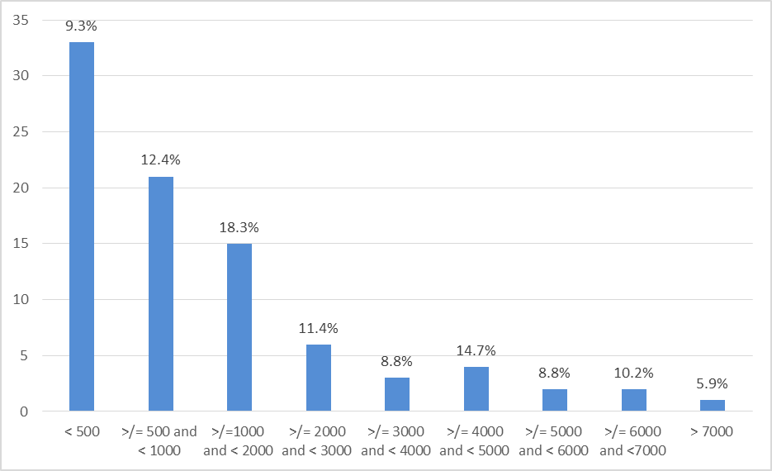
Deliveries at North Carolina Facilities by Volume

Slide 12
NC VLBW birth by Hospital total birth volume, 2014
1853 VLBW births
1487 (80%) born in hospitals with birth volume >3,000
228 born w/ 1000 – 2,999 birth
138 (5%) born w/ <1000 births

Slide 13
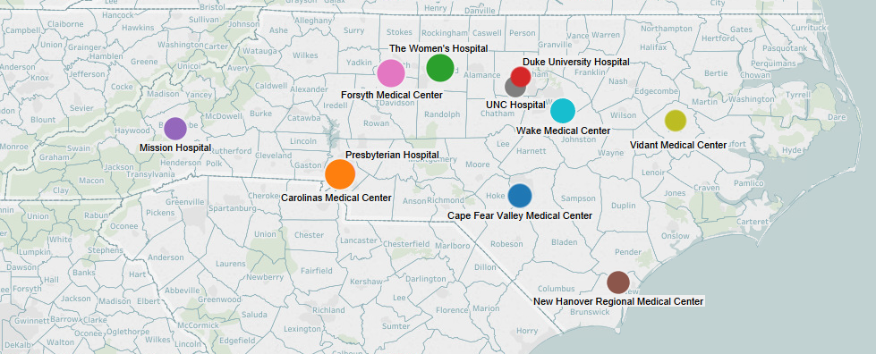
Notes:
Affiliation
Facility
2015 # Births
2015 % Births
Cape Fear Valley Health
Cape Fear Valley Medical Center
4585
3.77%
CHS
Carolinas Medical Center
7188
5.92%
Cone Health
The Women's Hospital
6172
5.08%
Duke Health
Duke University Hospital
3302
2.72%
Mission Health
Mission Hospital
4145
3.41%
NHRMC
New Hanover Regional Medical Center
4123
3.39%
Novant
Forsyth Medical Center
6190
5.09%
Novant
Presbyterian Hospital
5064
4.17%
UNC
UNC Hospital
3601
2.96%
Vidant
Vidant Medical Center
3733
3.07%
WakeMed
Wake Medical Center
4944
4.07%

Slide 14
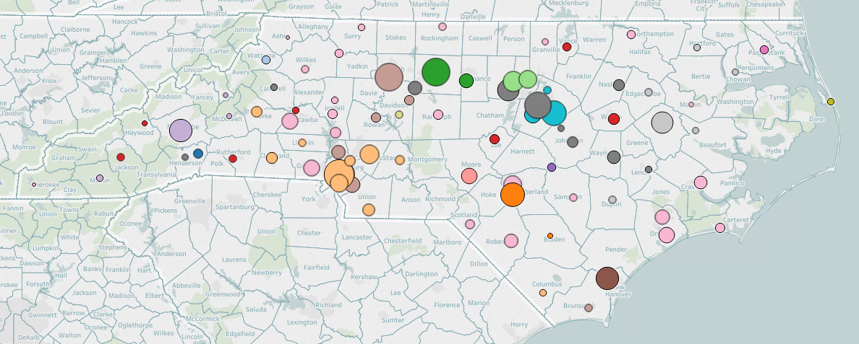
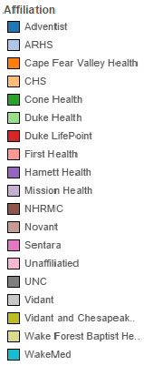
Notes:
All

Slide 15
risk appropriate Intrapartum care
Are the highest risk babies born in facilities with resources and personnel to provide appropriate care?
What are the capabilities/Level of neonatal care for NC maternity hospitals?
How is Level of care designated?
What systems are in place for maternal transport, when indicated?
What systems are in place for outreach education and support for quality monitoring and improvement?
Why are 20% of babies <1500 grams born in hospitals with low delivery volume? Are the maternal and neonatal resources appropriate?
Where are the service gaps? How can they be filled?

Slide 16
What about the mom?

Slide 17
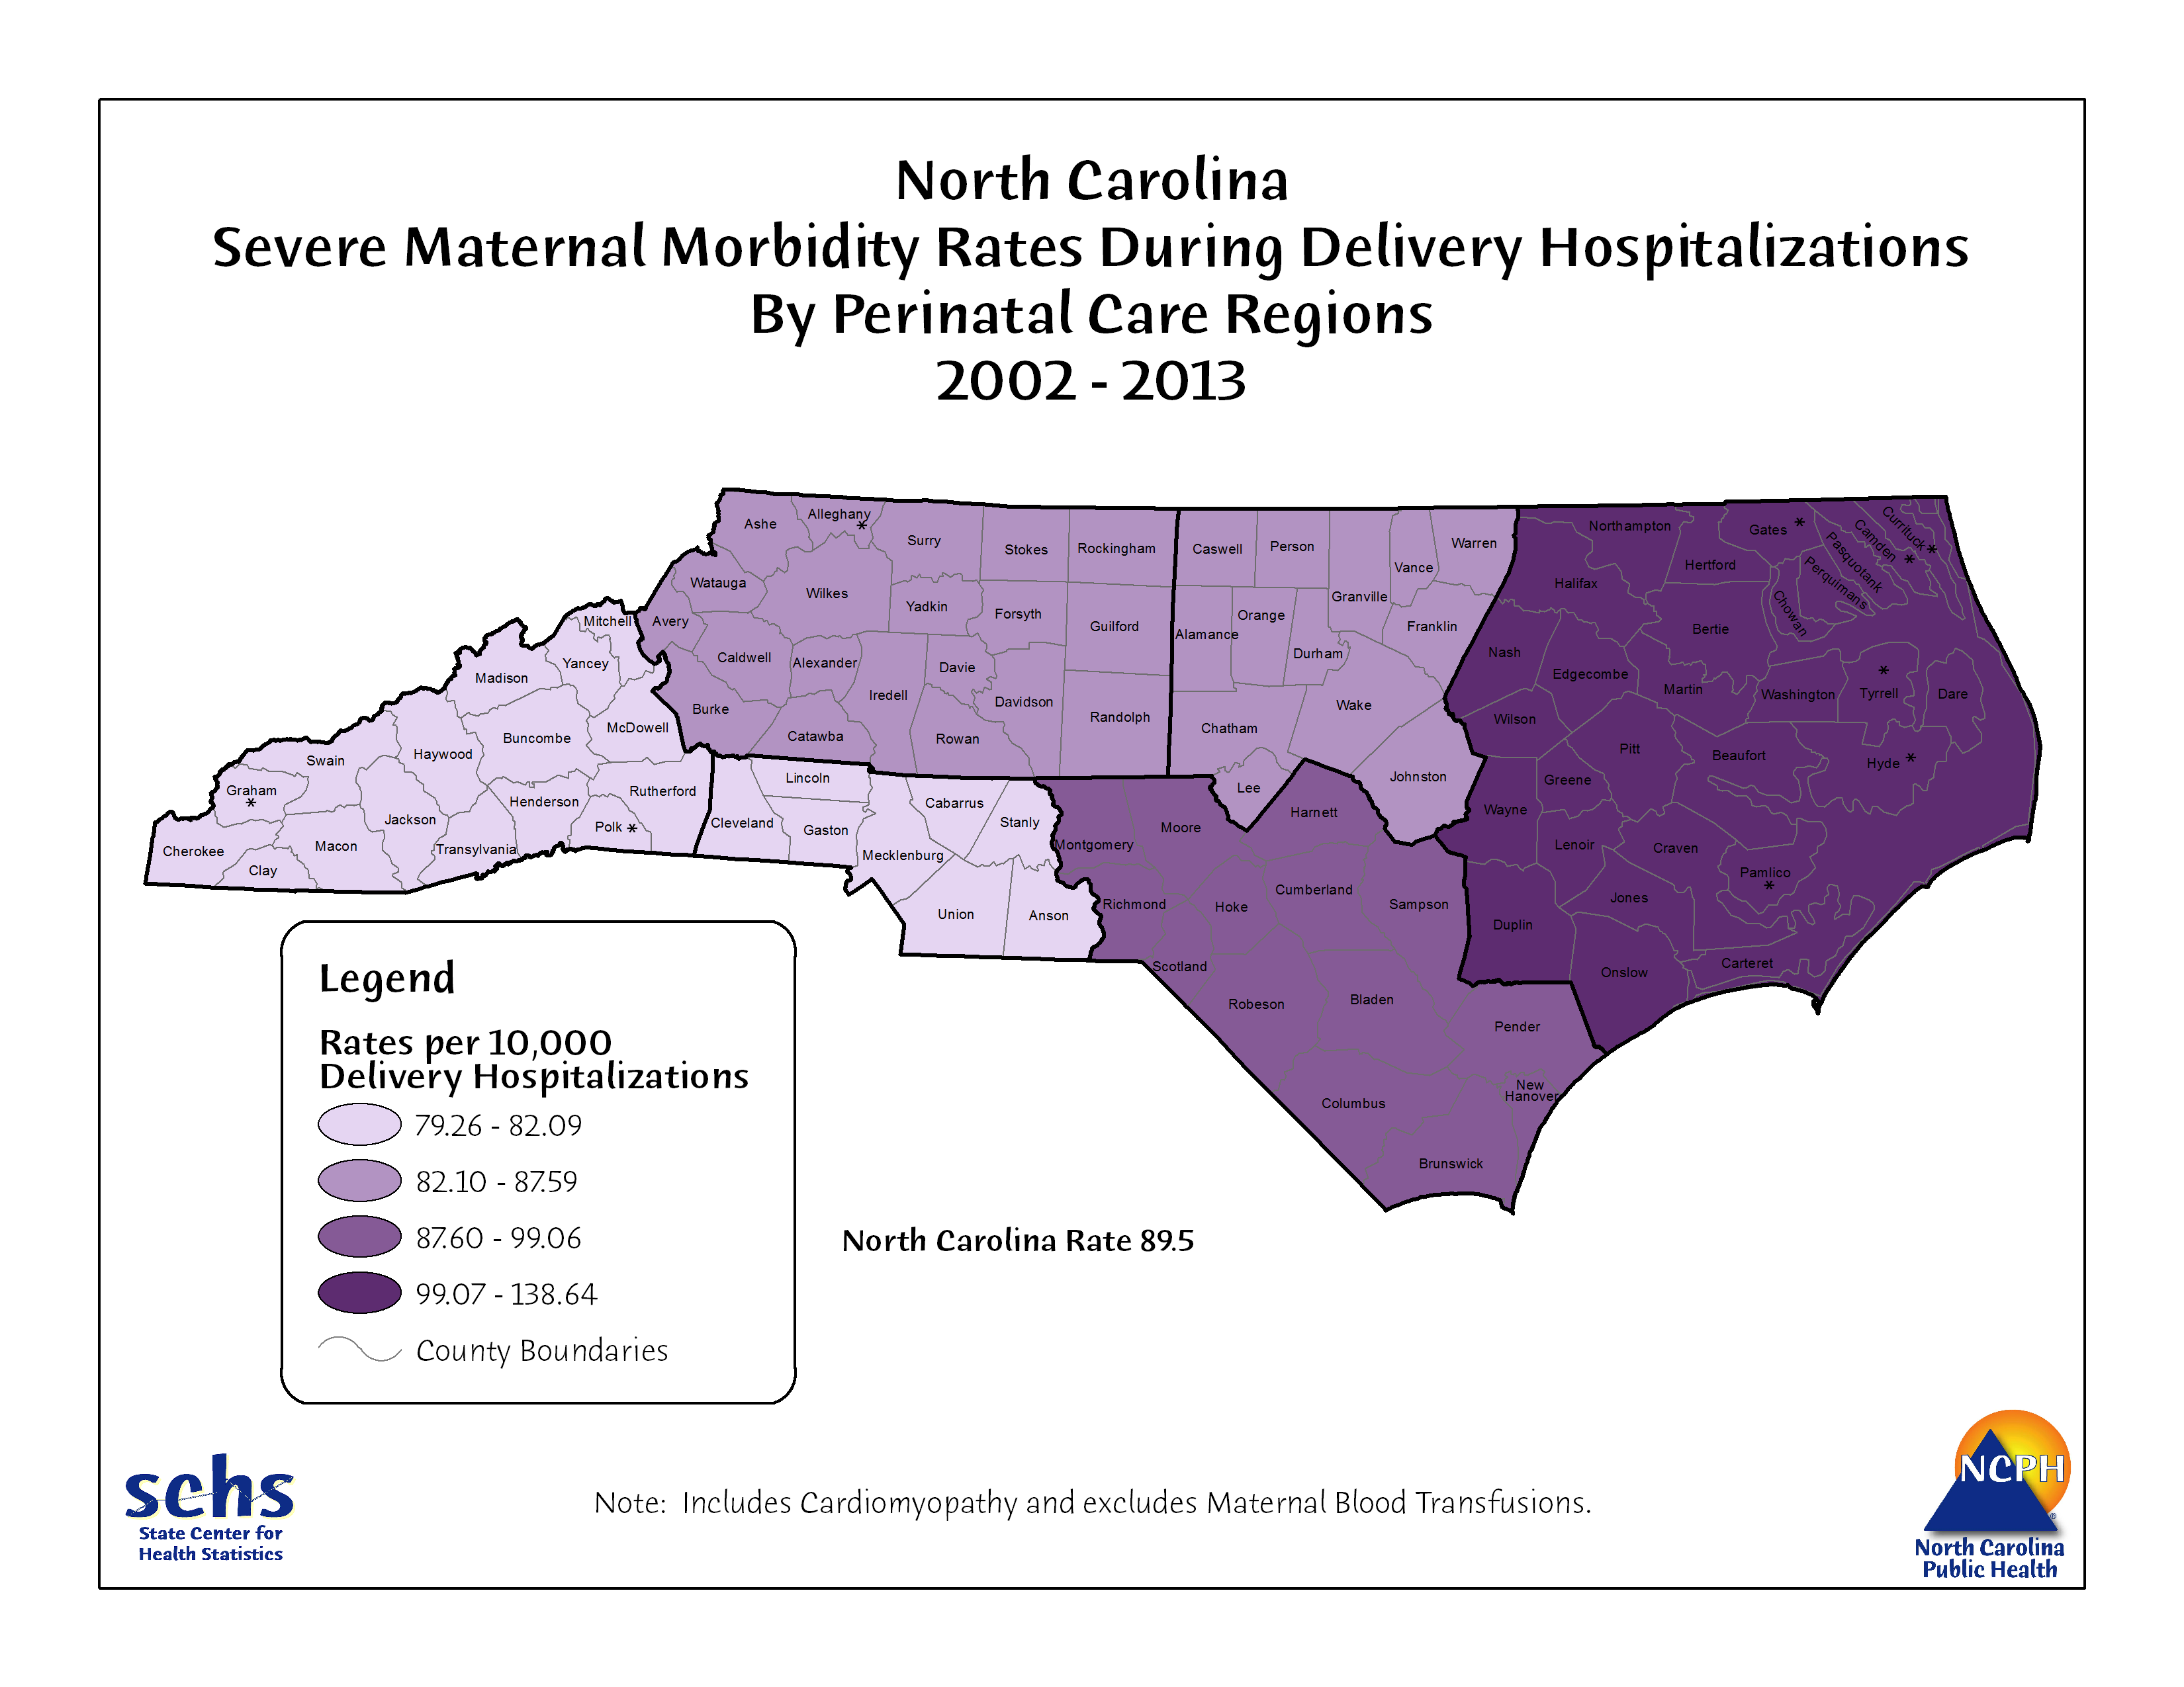

Slide 18
defining Levels of Maternal Care
To introduce uniform designations, with standardized definitions for levels of maternal care that are complementary but distinct from levels of neonatal care
To provide consistent guidelines according to level of maternal care for use in quality improvement and health promotion
To foster the development and equitable geographic distribution of full-service maternal care facilities and systems that promote proactive integration of risk-appropriate antepartum, intrapartum, and postpartum services

Slide 19
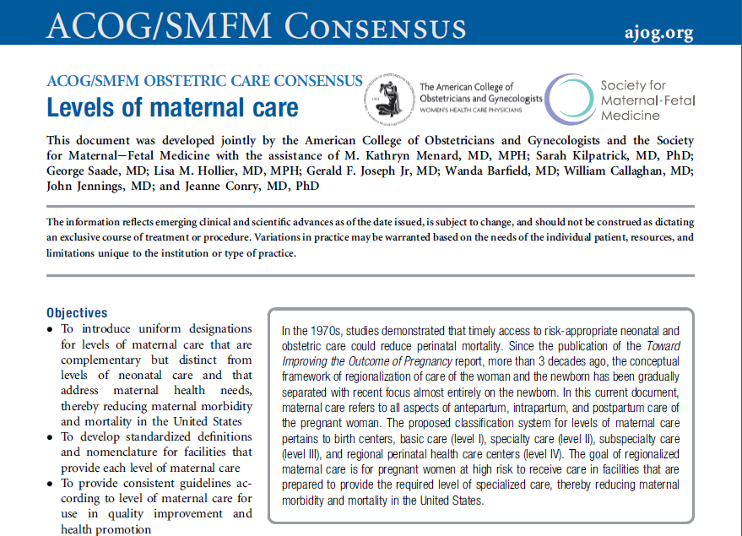
Levels of Maternal Care
Provide nationally applicable uniform definitions describing capability of facilities to provide increasing complexity of care to pregnant women
Endorsement and support from
American Association of Birth Centers
American College of Nurse Midwives
Association of Women’s Health Obstetric and Neonatal Nurses
Commission for the Accreditation of Birth Centers
American Academy of Pediatrics
American Society of Anesthesiologists
Society of Obstetric Anesthesia and Perinatalogy
Jointly published by ACOG and SMFM

Slide 20
Levels of Maternal Care (LOMC)
NOT about closing small or rural maternity care centers
IS about role of Level III/IV (Regional) Centers to support education and quality improvement among their referring facilities
IS about building a culture of collaboration
Notes:
Levels of Maternal Care recommends uniform designations for levels of maternal care that are complementary but distinct from levels of neonatal care. These designations are based on a facility’s ability to manage various levels of maternal care and include: Birth Centers, Level 1 (Basic Care), Level II (Specialty Care), Level III (Subspecialty Care), Level IV (Regional Perinatal Health Care Centers). Each healthcare facility should have a clear understanding of its own classification, as well as a well-defined threshold and system for transferring women to facilities that offer higher levels of care, if needed.
Levels of Maternal Care is the first-ever ACOG guidance that establishes levels of care specific to the pregnant woman. While current Guideline for Perinatal Care, jointly developed by AAP and ACOG focuses modtly on the newborn, Levels of Maternal Care is unique in its efforts to specifically address maternal health needs, thereby promoting proactive integration of risk-appropriate maternal care and reducing maternal morbidity and mortality in the United States.
This is an effort to endure that all birthing facilities are tolled to take good care of women
This is NOT about closing small or rural birthing facilities, rather an effort to support them through structured collaboration with higher level hospitals.

Slide 21
LoMC: Definitions/Examples
Birth Center | Low-risk w/ uncomplicated singleton term pregnancies, vertex presentation; Expected to have uncomplicated birth | Term, singleton, vertex
Level I | Uncomplicated pregnancies; Detect, stabilize, and initiate management of unanticipated problems that occur during antepartum, intrapartum, or postpartum until transfer | Term twins Uncomplicated cesarean Preeclampsia w/o severe features
Level II | Level I facility plus care of appropriate high-risk conditions, both directly admitted and transferred from another facility. | Severe pre-eclampsia Placenta previa w/ no prior uterine surgery
Level III | Level II facility plus care of more complex maternal medical conditions, obstetric complications, and fetal conditions | Placenta accreta/percreta; ARDS; Expectant management severe preeclampsia <34 wks
Level IV | Level III facility plus onsite medical and surgical care of the most complex maternal conditions and critically ill women and fetuses | Severe cardiac conditions or pulmonary htn Requires neurosurgery

Slide 22
3. Improve the quality of prenatal care
3C. Improve access to and utilization of first trimester prenatal care
3E. Ensure that all pregnant women and high-risk infants have access to the appropriate level of care through a well-established regional perinatal system
1. Decrease the % of VLBW and high-risk babies who are born at Level 1 and Level 2 hospitals
2. Define, identify and promote centers of excellence for VBAC (vaginal birth after cesarean)
3. Assess the levels of neonatal and maternity care services for hospitals using the consensus recommendations of the American Academy of Pediatrics (AAP), the American College of Obstetricians and Gynecologists (ACOG), and the Society for Maternal-Fetal Medicine (SMFM)

Slide 23
Recommendation: Informed action plan
Commission a broadly representative task force to study degree to which NC women receive risk appropriate maternal and neonatal care
Who is available to provide prenatal care? Where?
Why do only 65% of Medicaid recipients receive prenatal care in the first trimester?
Are the highest risk babies born in facilities with resources and personnel to provide appropriate care? Why are 20% of babies <1500 grams born in hospitals with low delivery volume?
Are maternity hospitals equipped for safe maternal care? Do the highest risk mothers have access to necessary resources for high quality care/
Where are the service gaps? How can they be filled?

